Slide 1
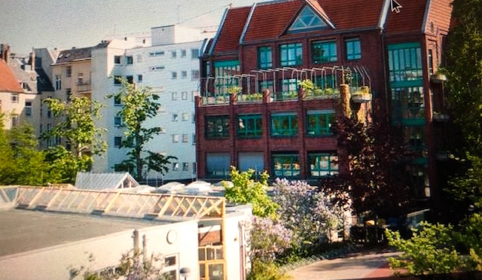
FRIEDENSBURG OBERSCHULE BERLIN
The largest public bilingual school in Europe
German and Spanish
Nominated among the first 20 schools to candidate for the Prize for the Best School in Germany

Slide 2
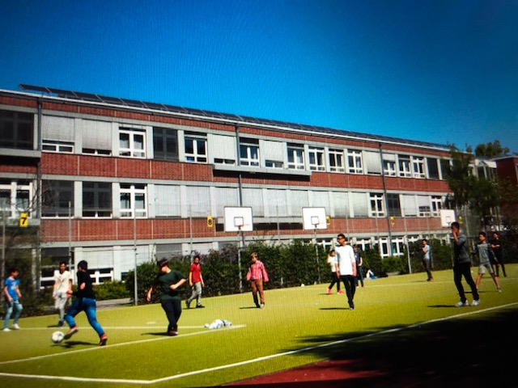
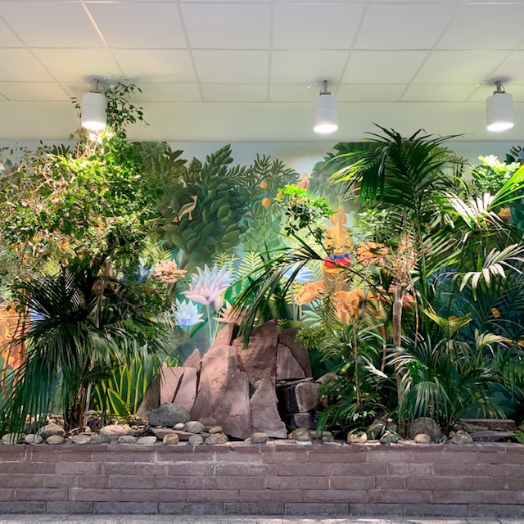
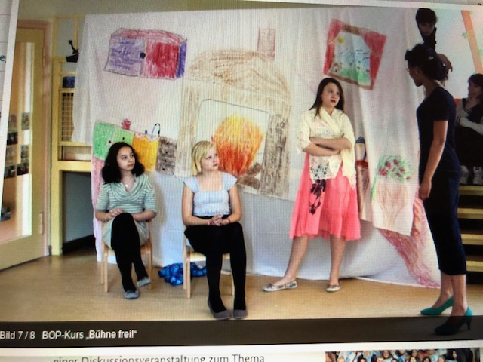
FOS images

Slide 3
FOS Table of Contents
1. General Information
- type of school
- type of classes
- extra-curricular activities
2. Exams at FOS
- BBR
- MSA
- A-Levels (ABI)
3. Cafeteria and laboratories
4. BOP courses
5. Internationals

Slide 4
FOS General Information
what we call in German ‚an integrated secondary school‘
the biggest European bilingual school in Berlin
about 1.200 students and over 100 teachers
a lot of them from Spain, Latin-America, but also Eastern-European and Arabic countries
very diverse school, both teachers and students come from over 70 different countries
there are 5 buildings and 2 schoolyards, we have a lot of regular classes as well as laboratories, special art rooms, sports‘ halls,
we have junior highschool (7-10th grade) and senior highschool (11-13th grade)
each junior high year has 4 bilingual and 4 German classes
the students of the senior high are mixed up

Slide 5
FOS General Information
we have 2 Wellcome classes for refugees and migrants, there used to be 4 of them
we have 2 laptop classes in each junior high, as well as a music-profiled class
at the end of the 13th grade the students achieve their A-Levels
schedule from 8 to 4, depending on year and AG taken
most common subjects taught are German, Spanish, Mathematics, Physics, Chemistry, Arts, Sports etc
the foreign languages taught are Spanish, French and Russian

Slide 6
The structure of the school
has 6 buildings, among which there is a very very large spots hall.
In building one computer rooms, several classrooms, and the offices, amongst others, the Headmaster´s office
In building two the big library, a few teachers’ room, for example Mathematics, Spanish and Geography, class rooms and the cafeteria
In building three classrooms.
In building four, second floor the science and biology rooms as well as Physics and Chemistry and art rooms
In building five the senior students.
Building five the sports hall.
Freshly renovated

Slide 7
EXAMS AT FOS
BBR/EBBR (Die (erweiterte) Berufsbildungsreife)
the first qualification you obtain in high-school
the exam is taken in the 9th grade
taken in Mathematics and German
admission is a condition for the participation to the next ,exam, the MSA
over 90% of the pupils at FOS succeed it

Slide 8
EXAMS AT FOS
MSA (Der Mittlere Schulabschluss)
taken in the 9th grade in Mathematics, German and English
if you succeed it and don’t want to or cannot continue the education, you need it to start an apprentiship as a postman, shop-assistant etc
if your grade is better than a C (3) then you can continue your senior high education and do your A-levels in a senior high
if not there are other alternatives to do A-level similar qualifications
the majority of the students at FOS continue their education after the 10th grade

Slide 9
EXAMS AT FOS
A-LEVELS
written in the 13th grade
the written exams are taken mostly in the advanced courses, the oral ones in the basic courses
the A-Level are necessary for university studies such as Medicine, Informatics, Engineering, etc.
most of the students of the senior high at FOS succeed their A-Levels and study at the university

Slide 10
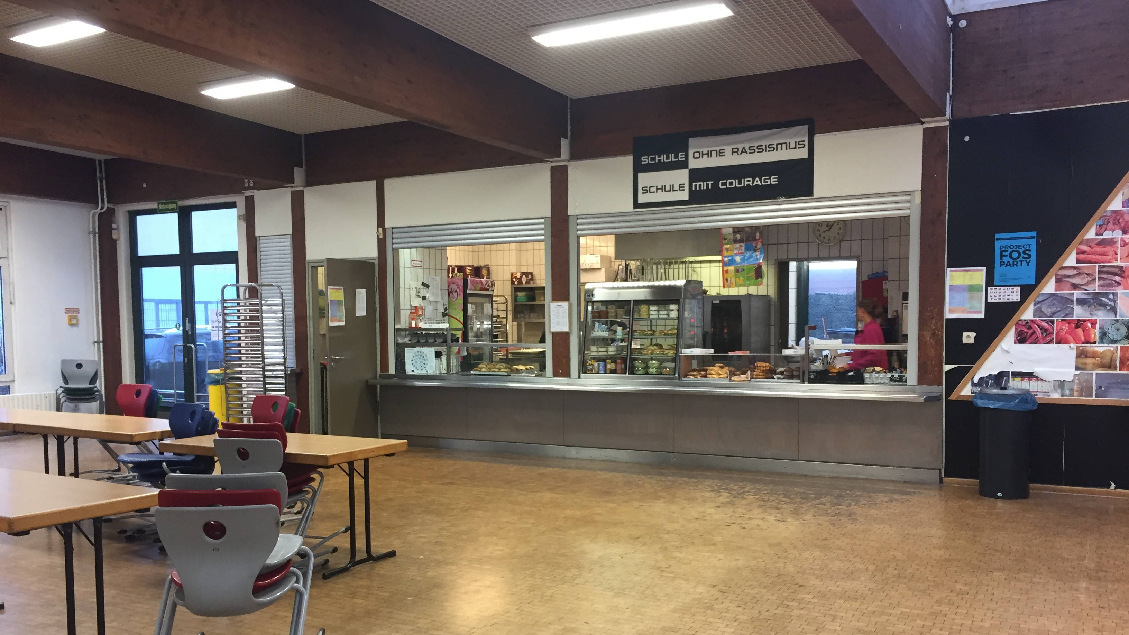
Cafeteria
This used to be our old cafeteria

Slide 11
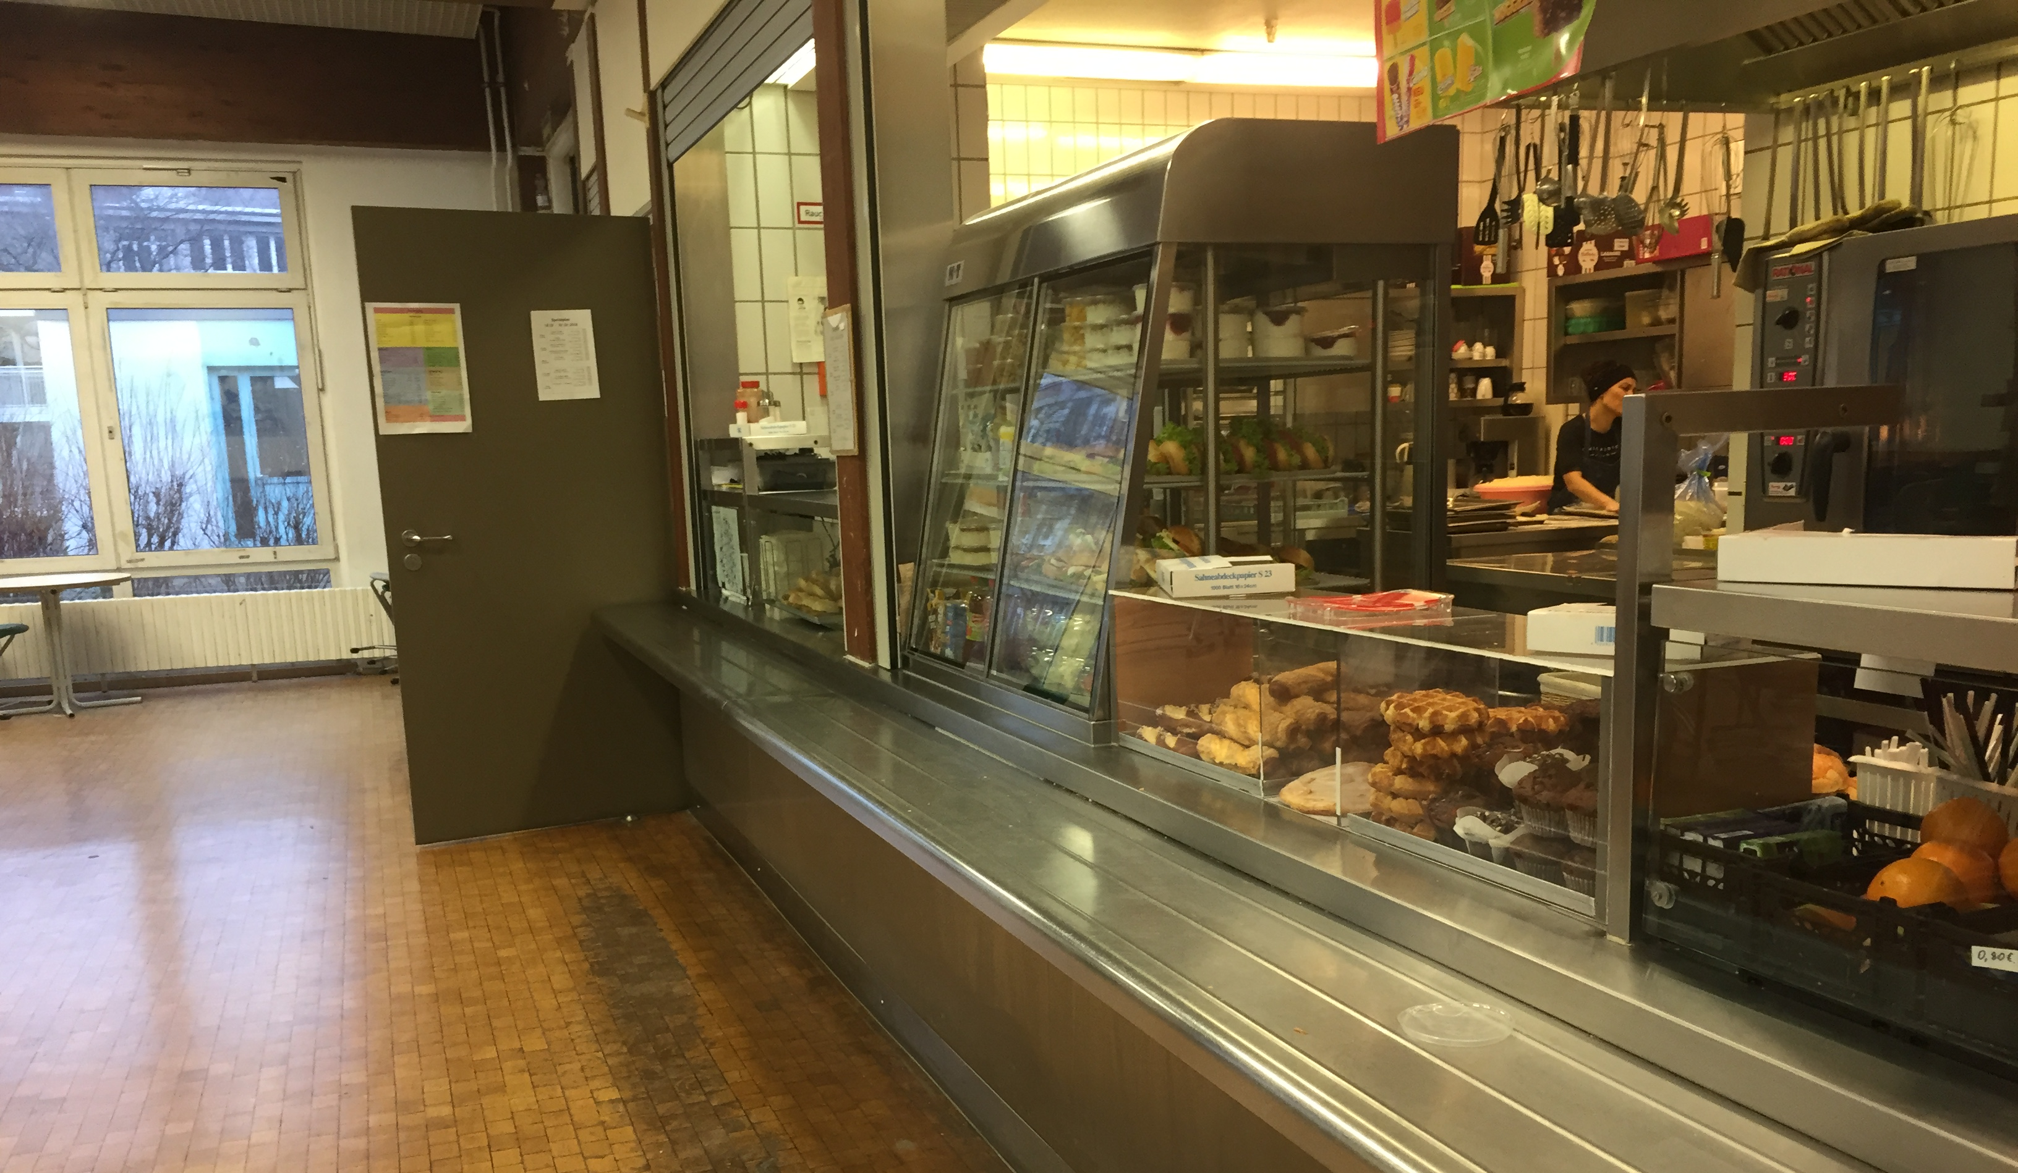
Cafeteria
This is our new cafeteria
In the breaks the cafeteria is very full
It has much variety in food

Slide 12
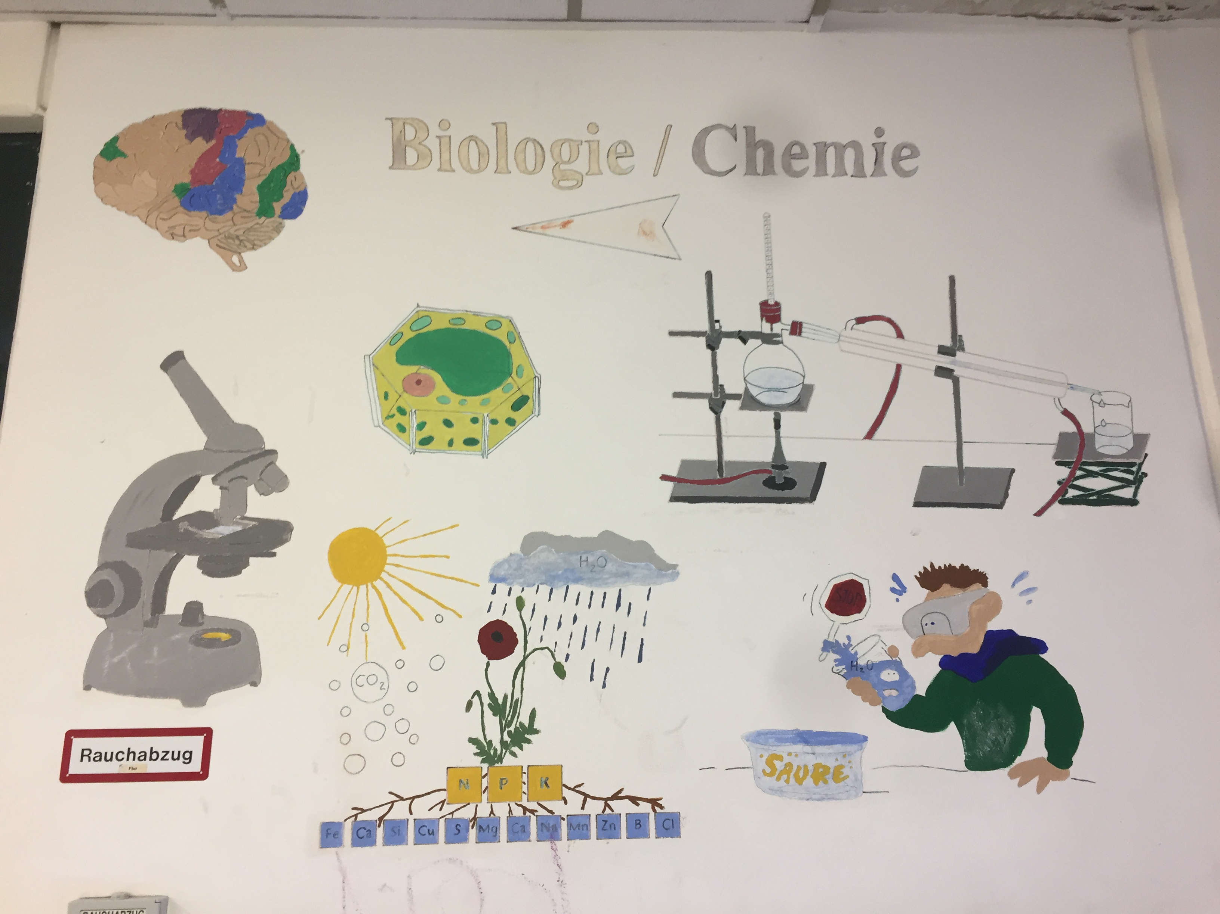
Biology

Slide 13
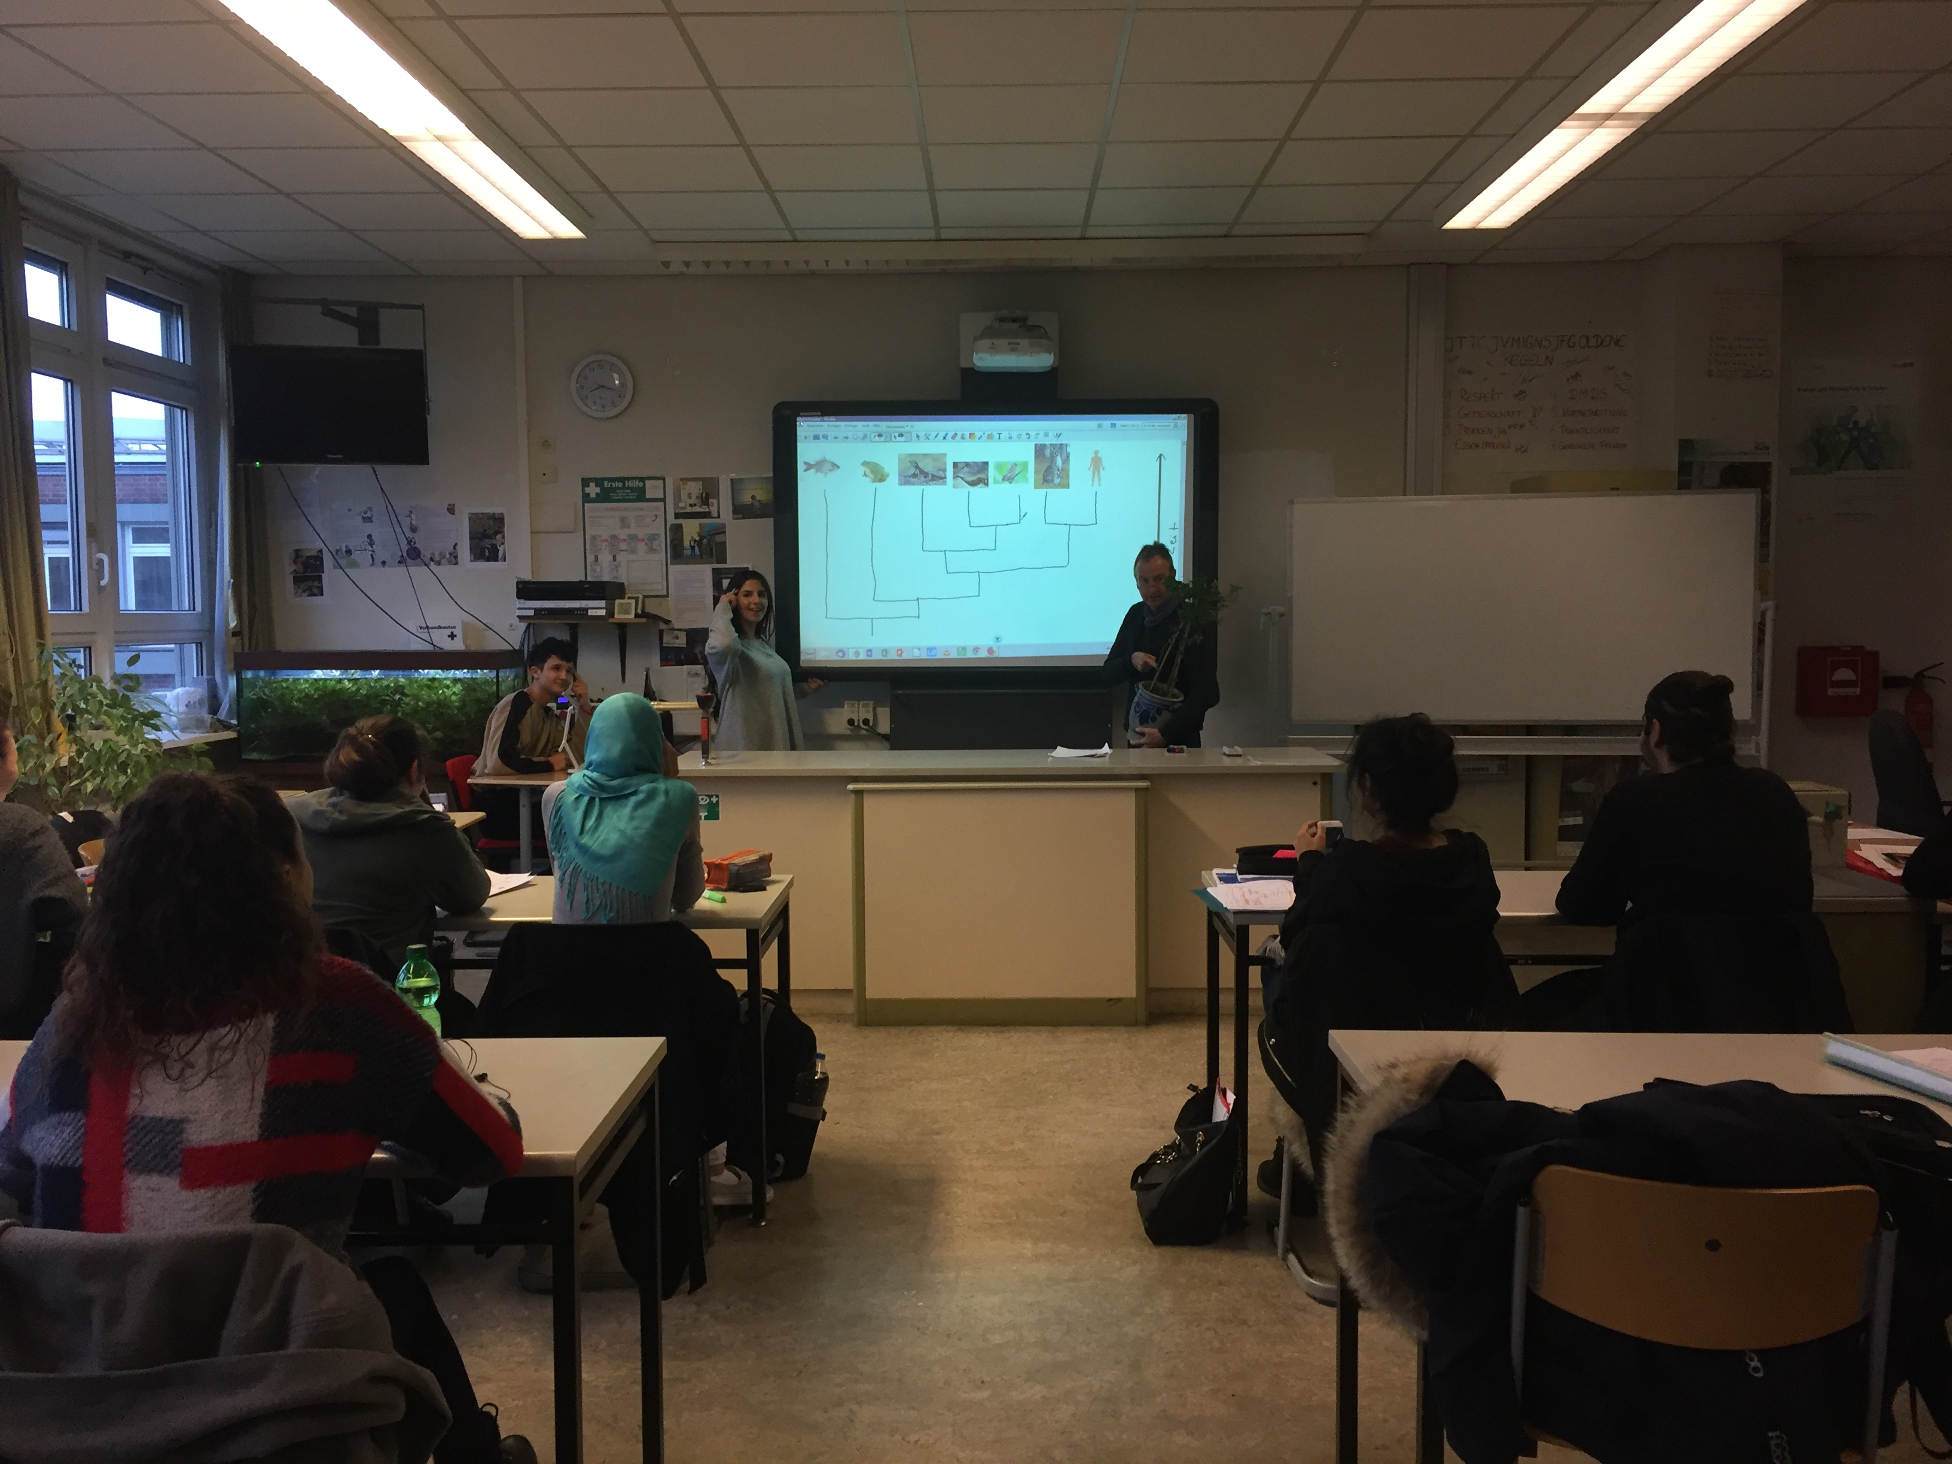
Biology
Special rooms
Many special materials for this class
The walls of the corridors are painted

Slide 14
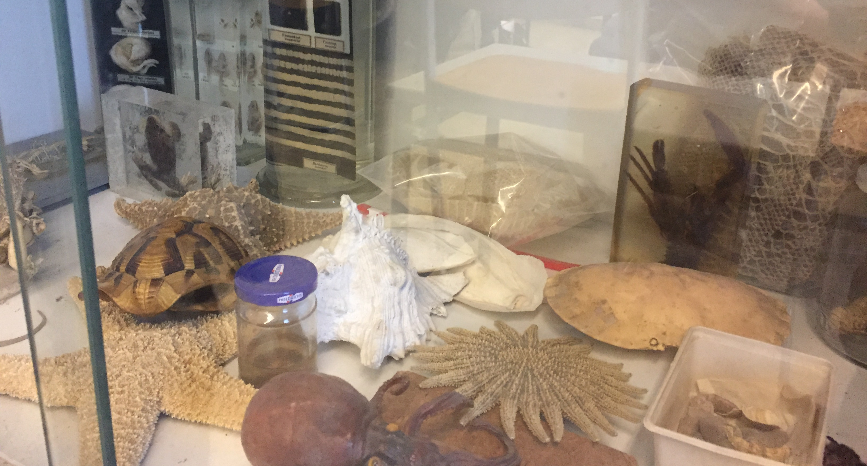
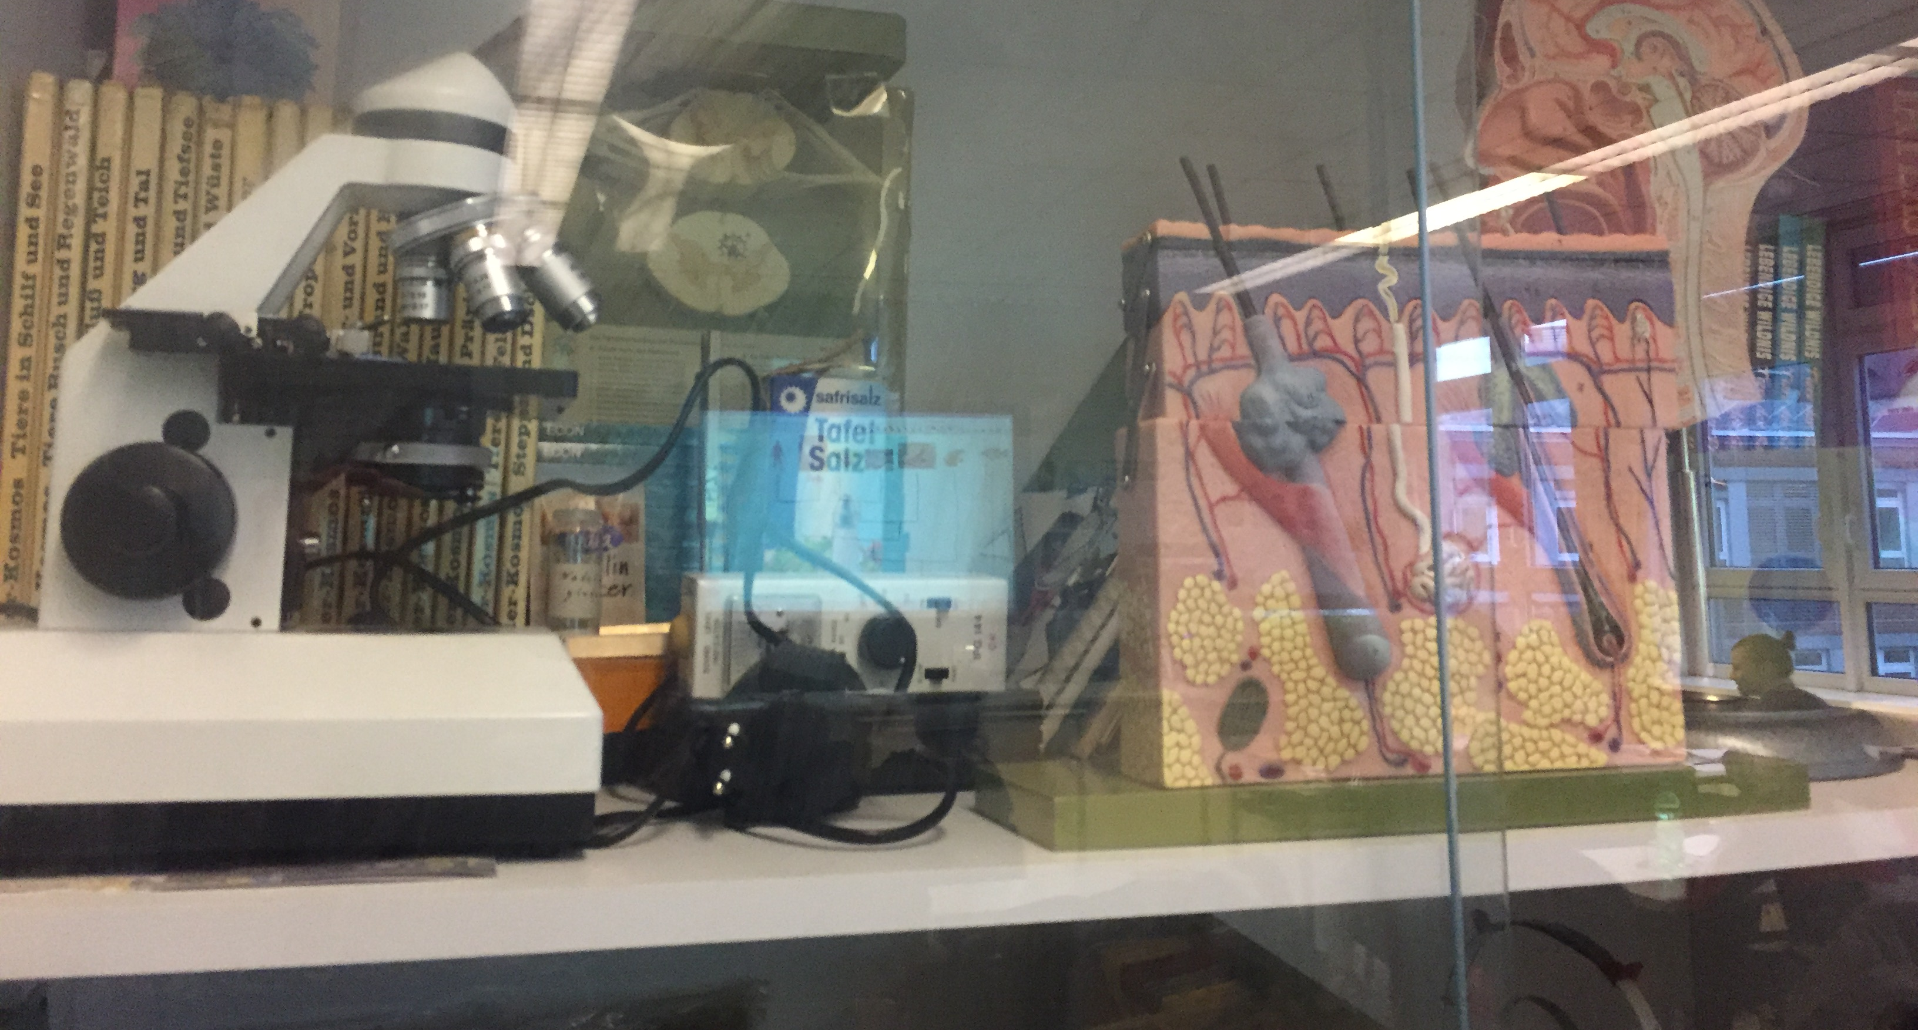
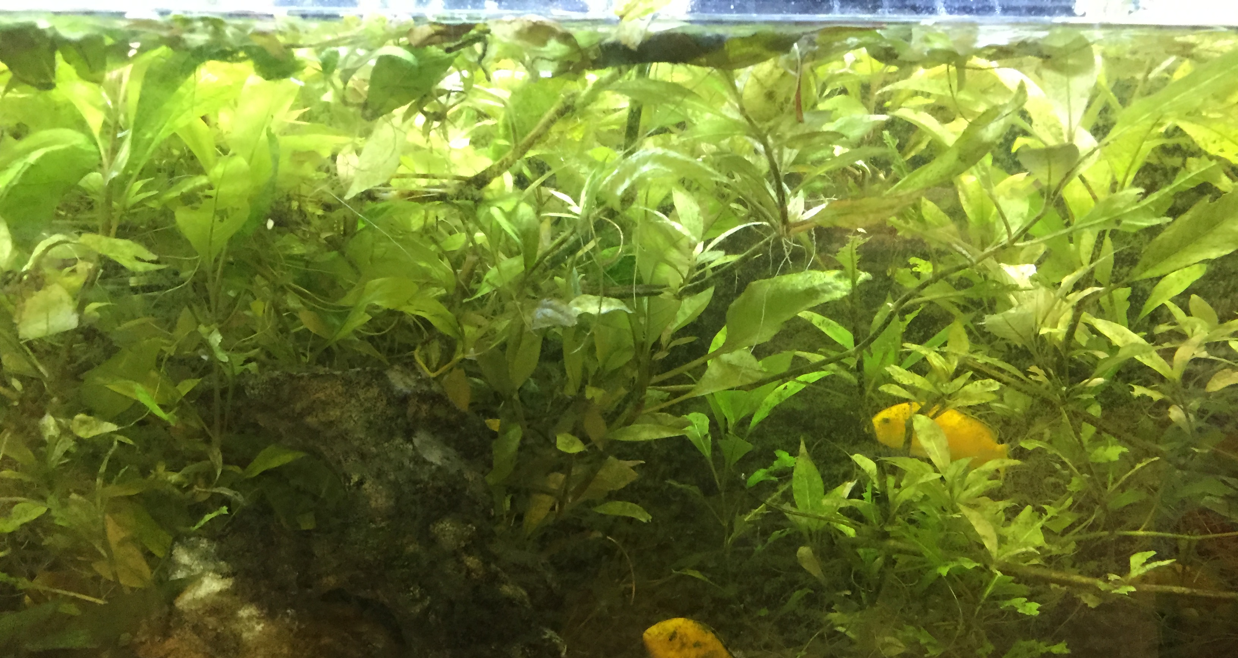
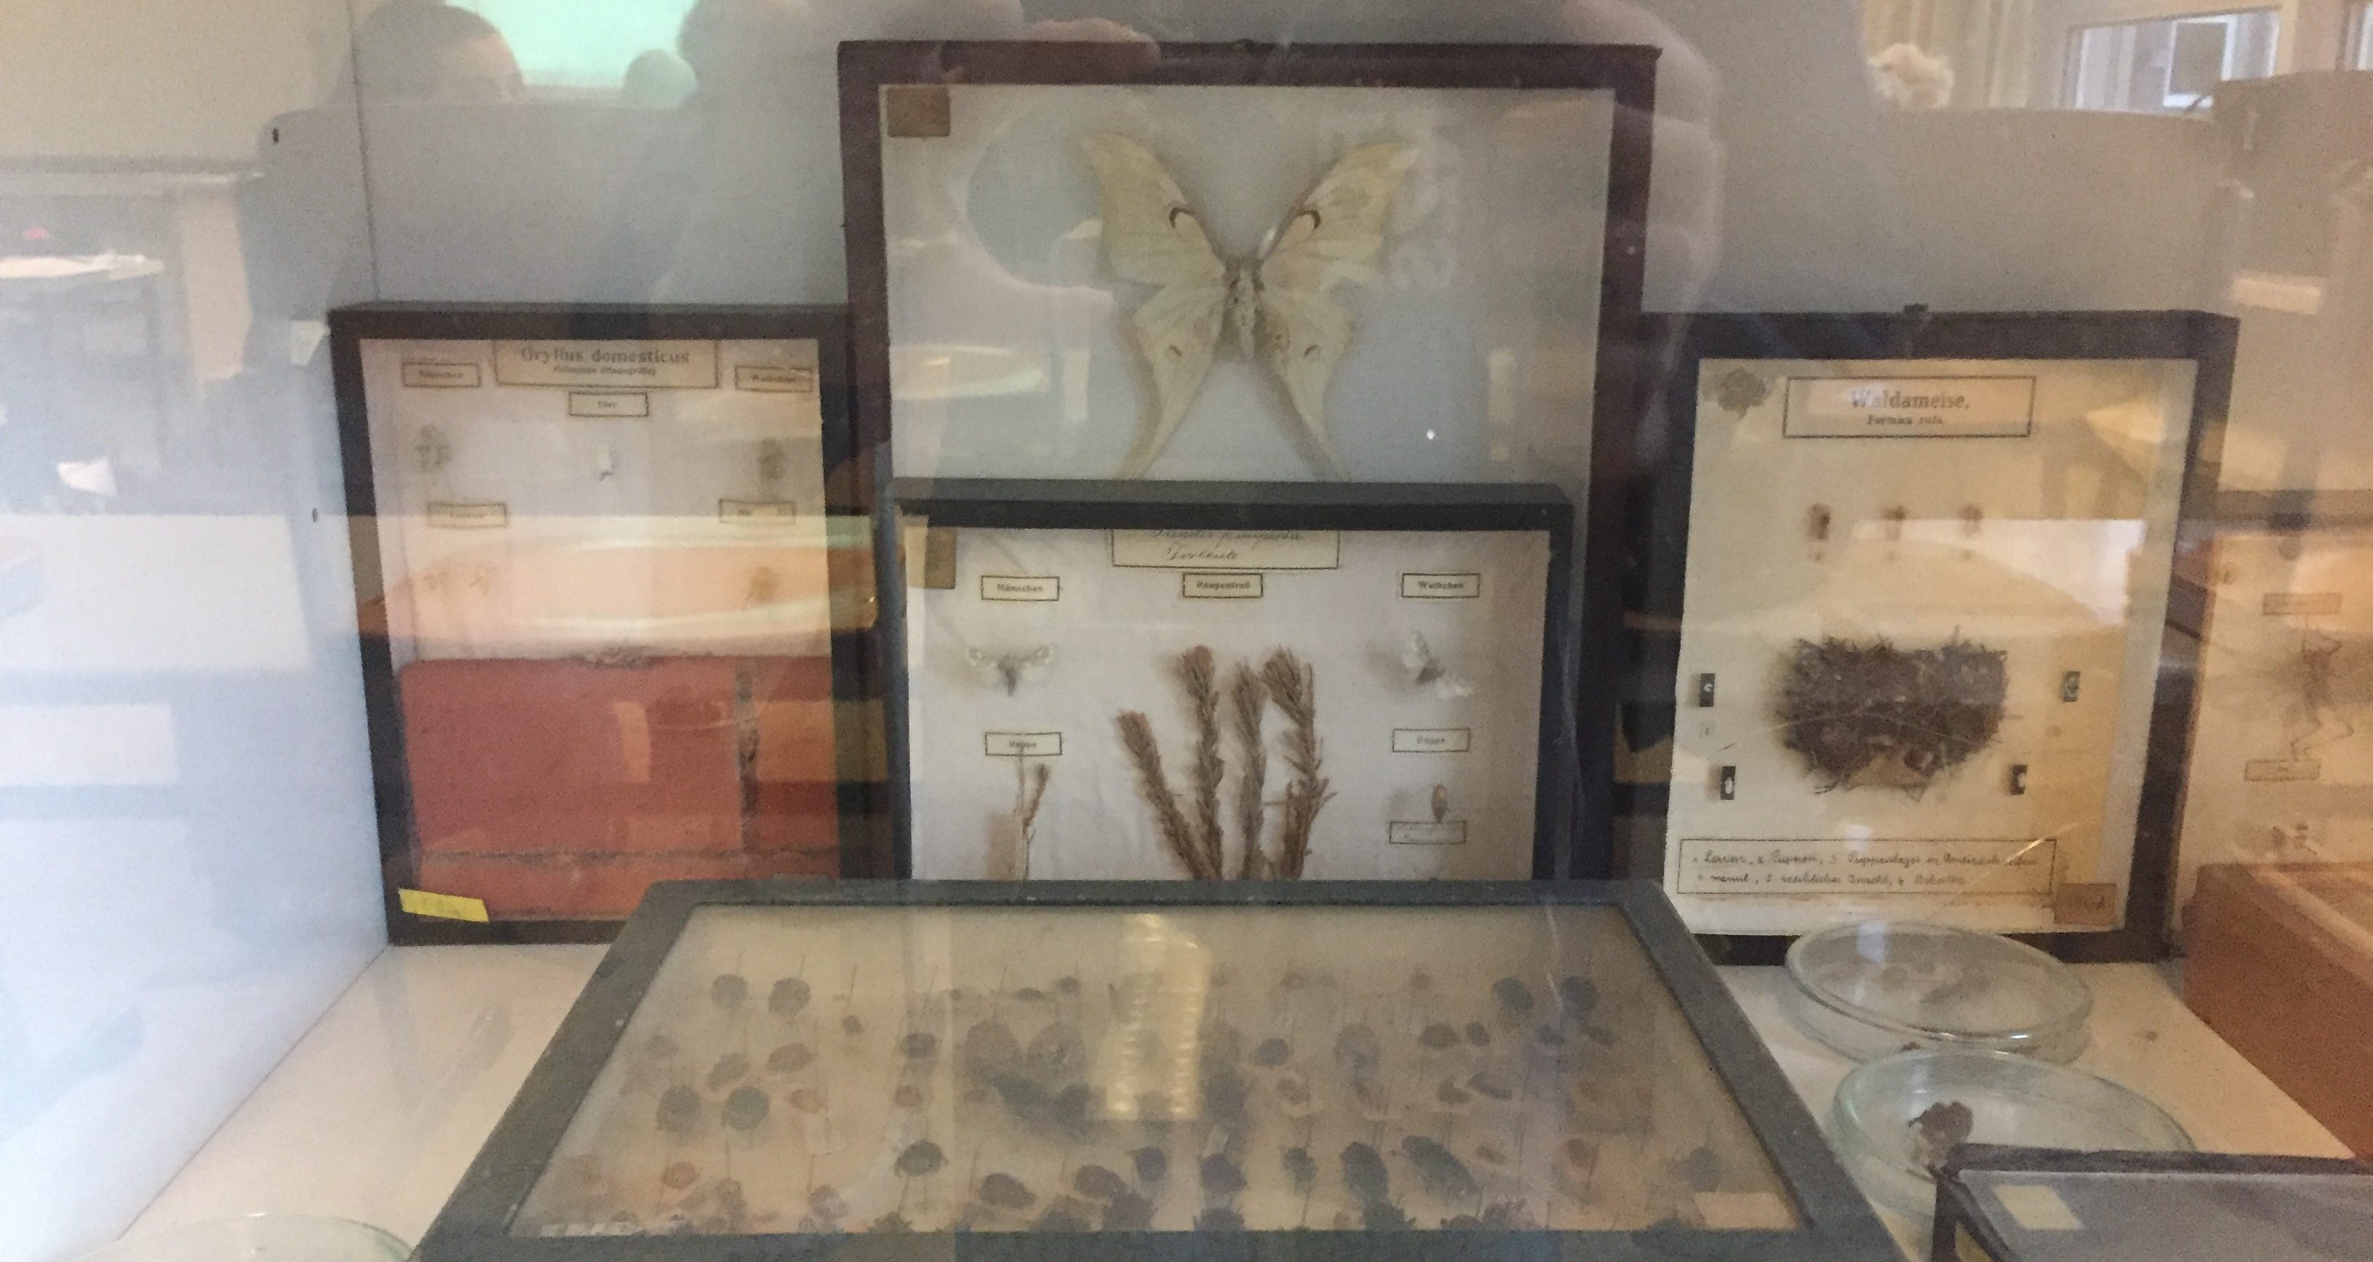

Slide 15
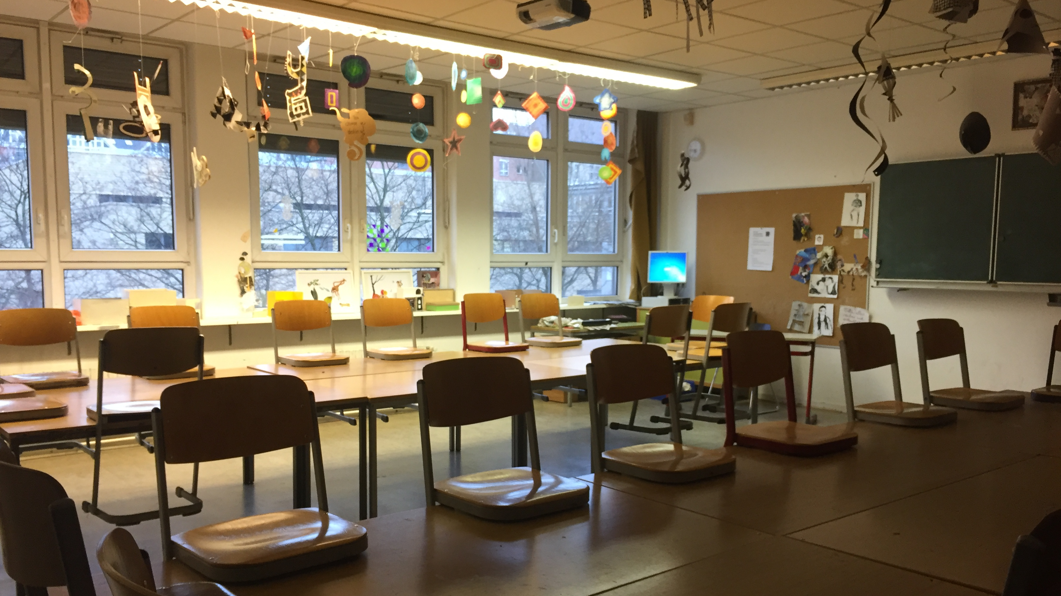
Art rooms
Frida & Juan

Slide 16
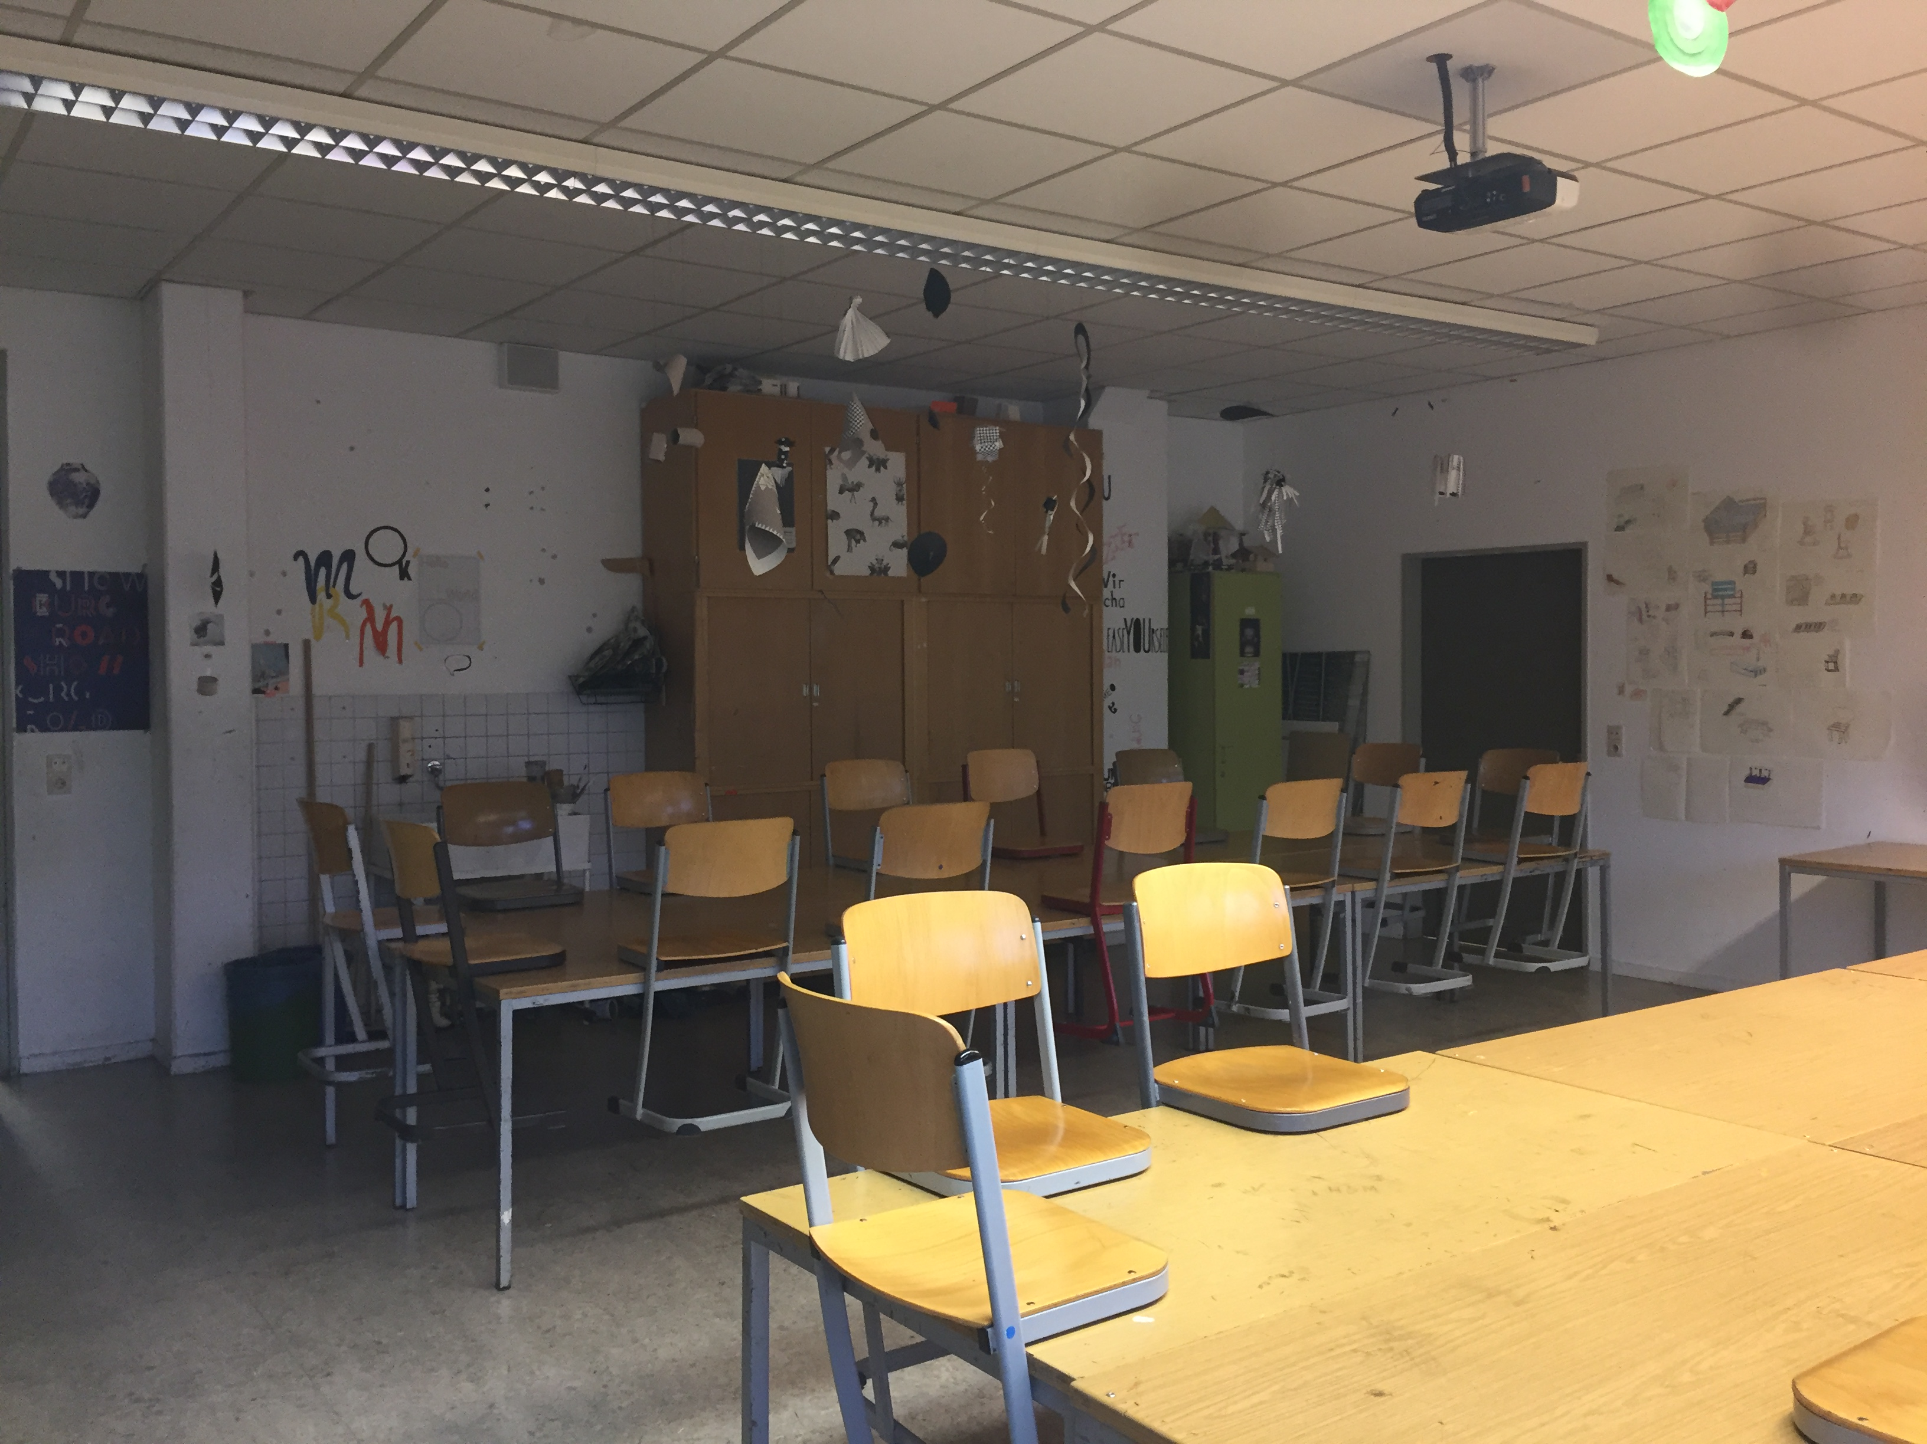
Art rooms
4 large classrooms + 2 storerooms + 1 staff room
In the rooms you´ll find:
1 computer
Wirrless internet access
1 projektor
1 sink
Art stuff
6 art teachers

Slide 17
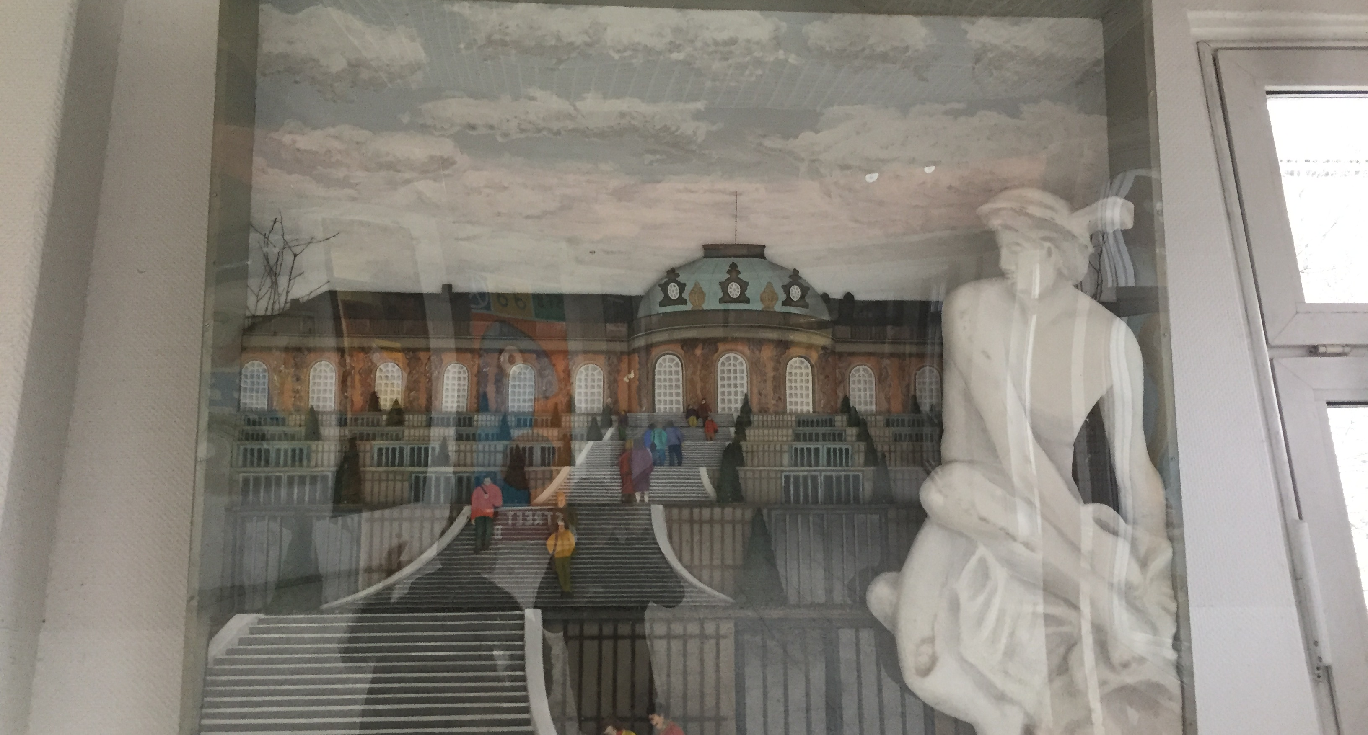
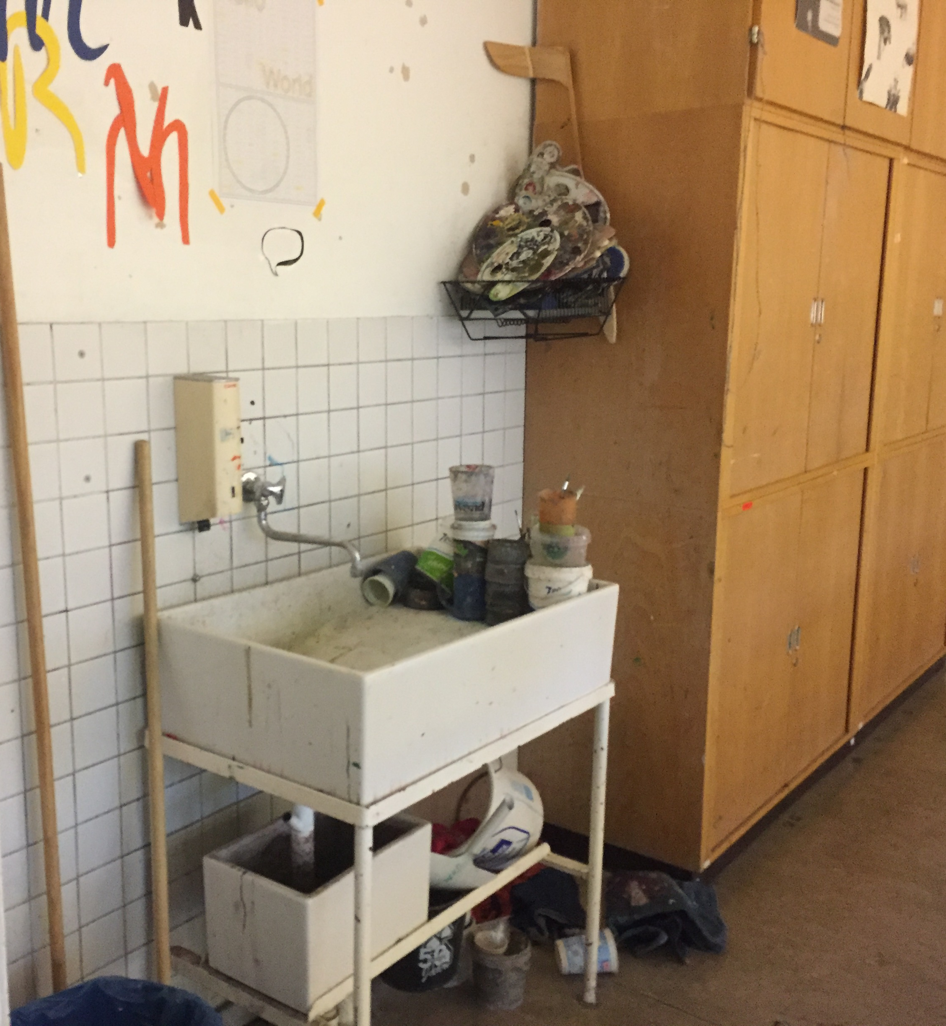
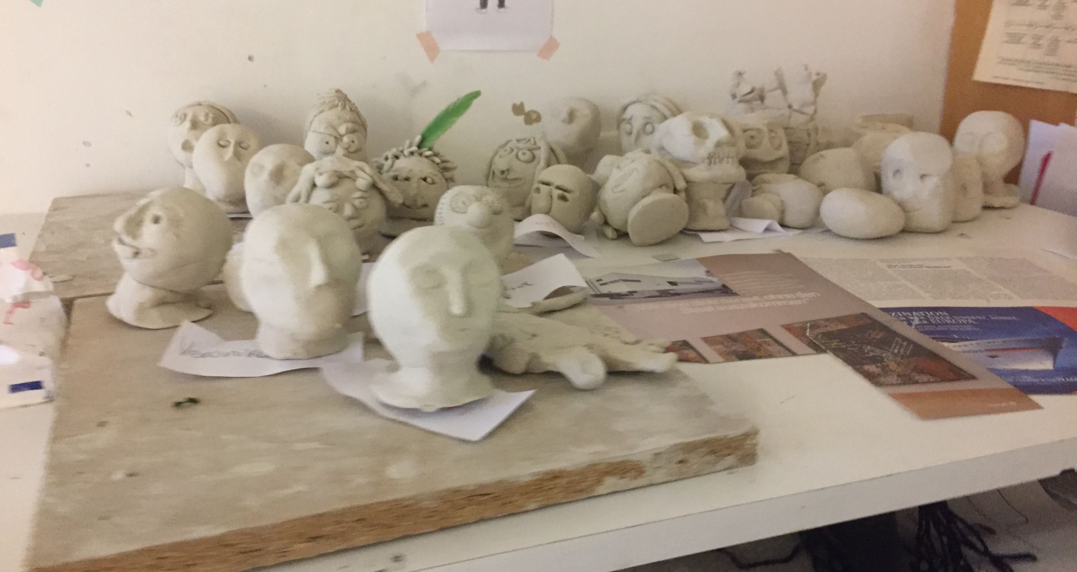

Slide 18
BOP stands for Beruf orientiertes Projekt , which means Job-oriented projects. All students can choose a BOP when they start school.
Bop Bio:
-One day a week you go to a communal garden where we grow our own veggies.
-You do many projects, take part on Jugendforscht, a German science competition for high school students.
-You learn a lot about nature and climate change
- We learn about raw materials
BOP
AT
FOS

Slide 19
Bop Art:
-You draw or paint a lot a variety of:
Outside
Plants
Stones
Collages
Bop MUK (Media and communication):
- You learn many things about computers, coding
- You learn how to cut videos
Bop basketball:
- Training Twice a week. Warm up, games, train for a Berlin tournament.
BOP
AT
FOS

Slide 20
BOP music:
You can choose one of the instruments the school provides.
We practice several music pieces for the concerts we play at our school. We also do field trips to practice.
BOP catering:
Students learn how to cook, how to combine flavors.
Students cook and eat the food together afterwards.At school events they organize the catering.
EXAMS
AT
FOS

Slide 21
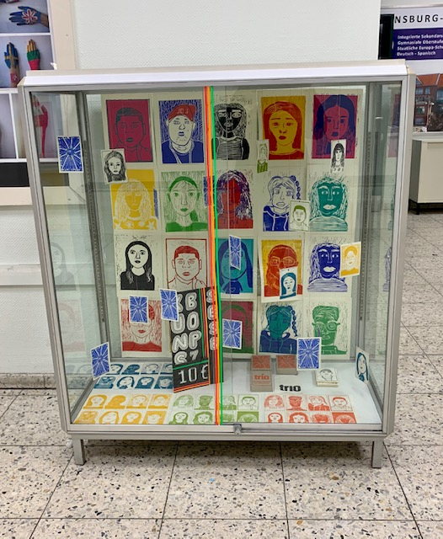
Thank you for your attention!!!

Slide 22
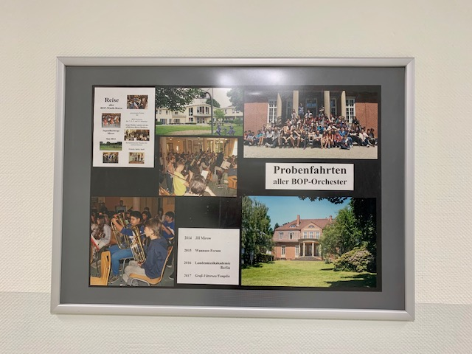
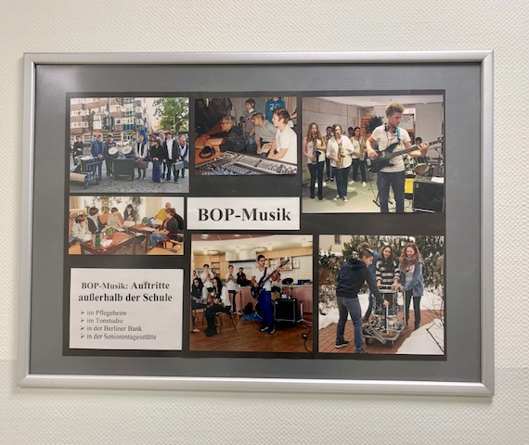
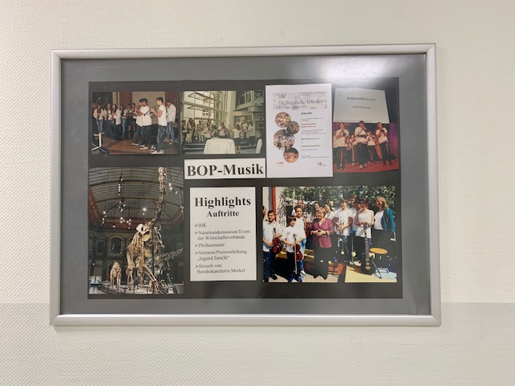
Our BOP orchestra gives concerts in and outside school

Slide 23
Often for entertainment and also charity purposes

Slide 24
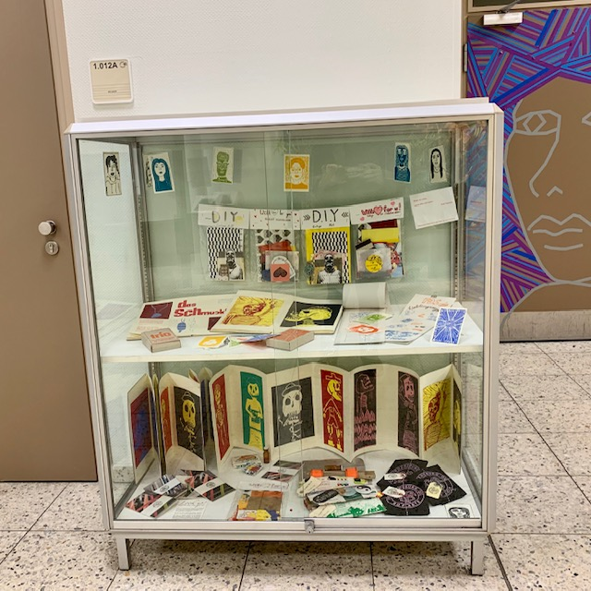
Our BOP Arts exhibits in our school halls

Slide 25
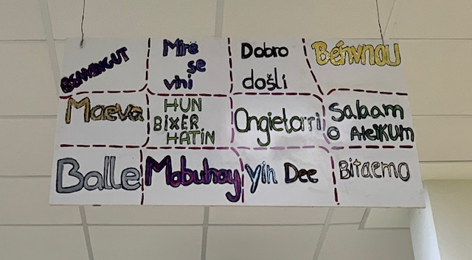
In BOP Translation we created welcome signs in 100 languages and translated the door signs in English and Spanish

Slide 27
