Slide 1
Chapter 2,
Me and the world and the world and I
About me §1
Relation with yourself §2
Relation with others §3
Views of humanity §4

Slide 2
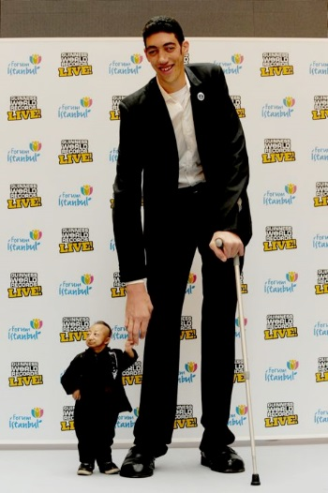
§1 About me
I’m unique
Is everyone different, with respect to the inner self and the outward appearances?

Slide 3
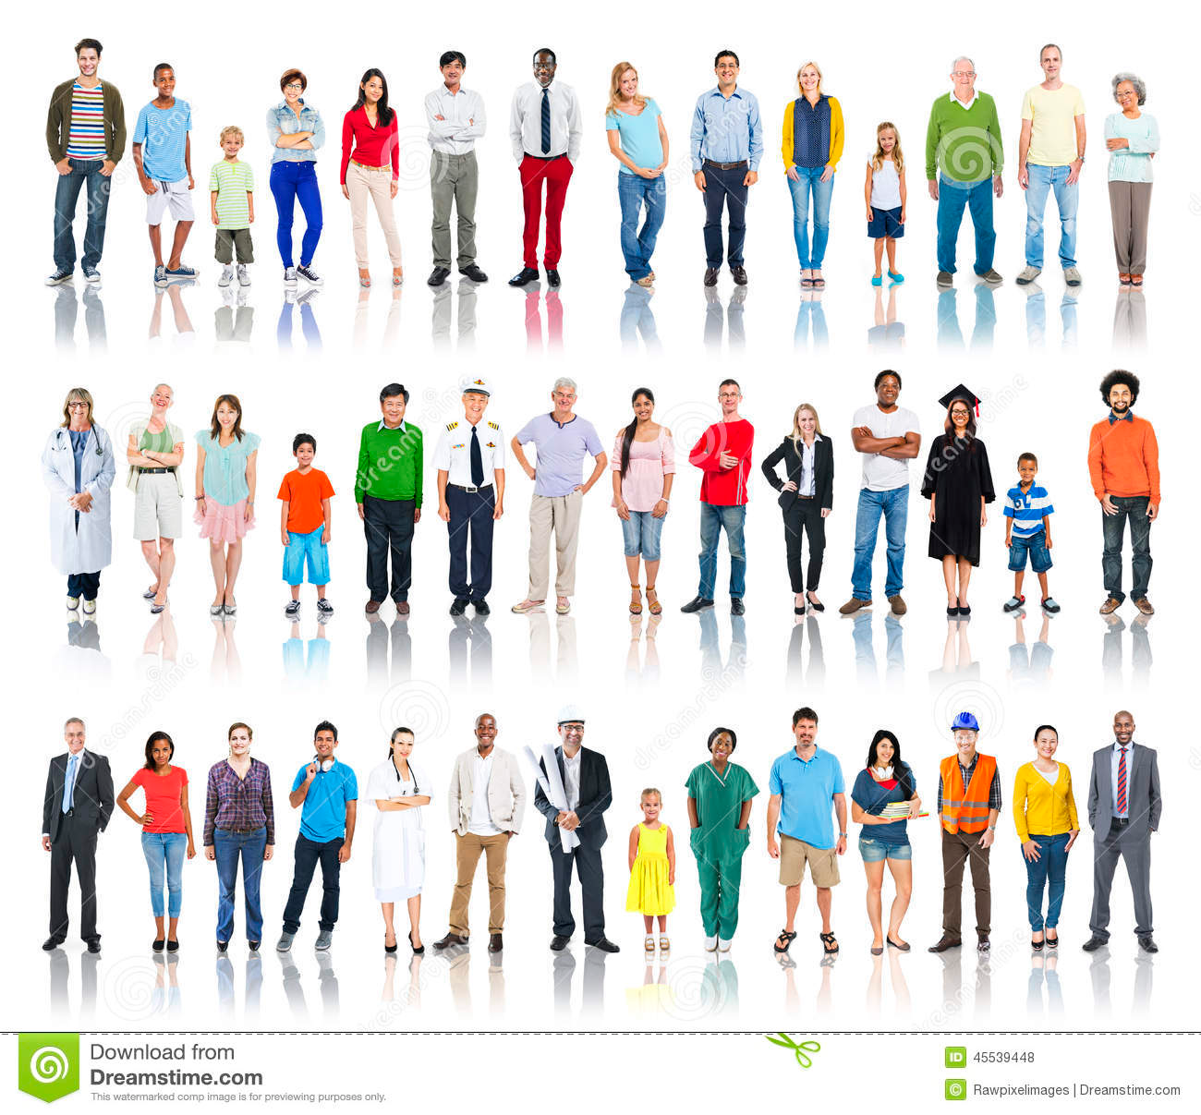
§1 About me
I’m unique and human
Can people be evenly valuable and precious although they are different?

Slide 4
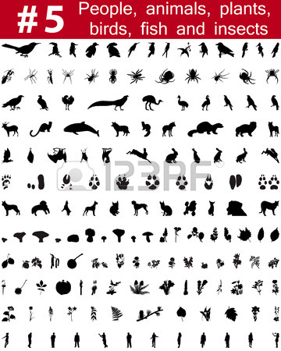
§1 About me
I’m unique, human and a living creature
If all people are evenly
valuable and precious, what about plants and animals?

Slide 5
§2 Relation with yourself
Knowing who you are
What is your philosophy of life, what is important?

Slide 6
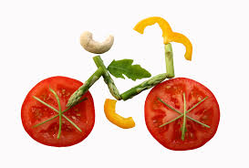
§2 Relation with yourself
Taking care of yourself, physically
Is it important to keep your body healthy?

Slide 7
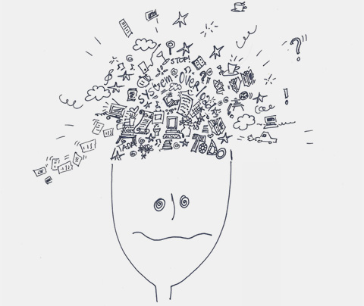
§2 Relation with yourself
Taking care of yourself, mentally
Is it important to keep your mind healthy?

Slide 8
§3 Relation with others
Freedom
What would the world look like if everyone would be free?

Slide 9
§3 Relation with others
Misuse of freedom
What would the world look like if nobody would misuse freedom?

Slide 10
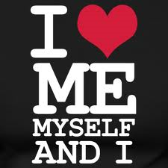
§3 Relation with others
Egoism
Is egoism a way of misusing freedom?

Slide 11
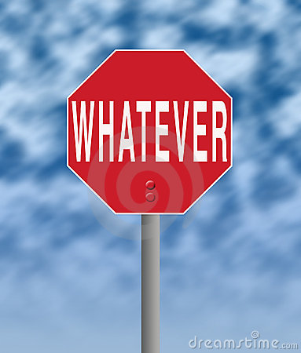
§3 Relation with others
Indifference
Is being indifferent a way of misusing freedom?

Slide 12
§3 Relation with others
Not taking responsibility
Is not taking responsibility a way of misusing freedom?

Slide 13
§3 Relation with others
People nearby and far away
Do we need to care for people far away in the same way as we care for people nearby?

Slide 14
§3 Relation with others
Living creatures nearby and far away
Do we need to care for living creatures far away in the same way as we care for living creatures nearby?

Slide 15
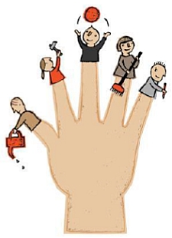
§4 Views of humanity
People are helpful beings
If helping is seen as important, we expect everyone to be helpful. Yes or no?

Slide 16
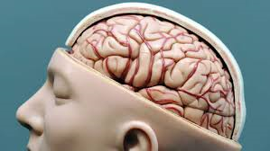
§4 Views of humanity
People are rational beings
If being rational is seen as important, we expect everyone to be rational. Yes or no?

Slide 17
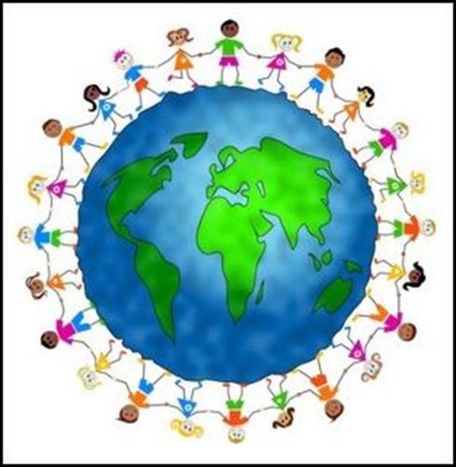
§4 Views of humanity
People are respectful beings
If being respectful is seen as important, we expect everyone to be respectful. Yes or no?

Slide 18
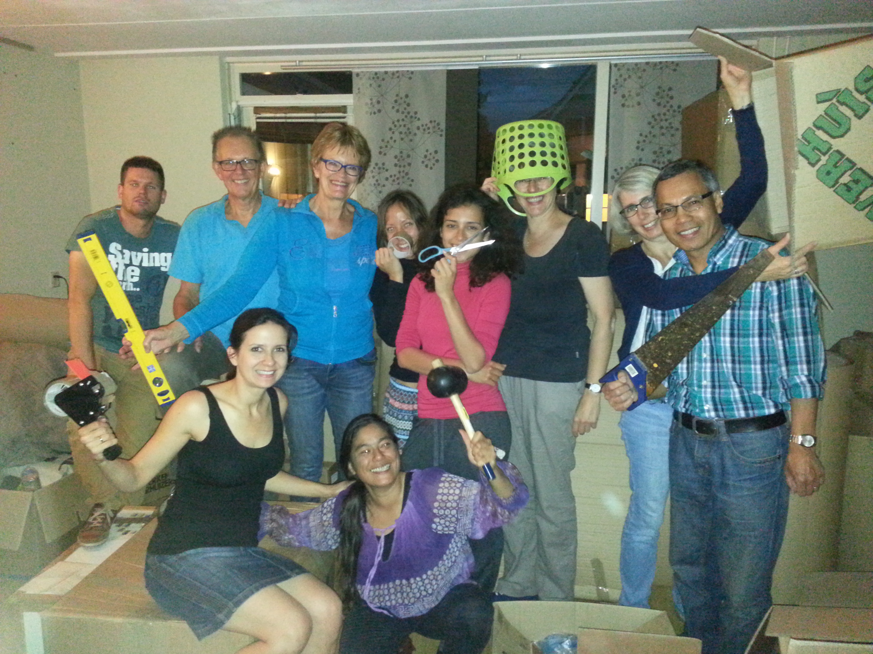
§4 Views of humanity
People are social beings
If being social is seen as important, we expect everyone to be social. Yes or no?

