Slide 1
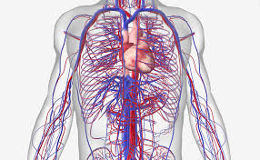
Chapter 3 The circulatory system

Slide 2
Arrange the classroom like this
Group 3
Group 2
Group 6
Group 4
Group 1
Group 7
Group 5

Slide 3
Groups
Aylin, Tuana, Oliwia
Maarten, Marjolein, Kaya, Milan
Apurjan, Gemma, Marijn, Mika
Ken, Chris, Nasr-Eddine
Tof, Vince, Sid, Raf
Kjeld, Janan, Michel
Juul, Dean, Caja, Fleur

Slide 4
Discussing test and poster
Test; What stood out?
2 answers given at multiple choice (not possible)
words (like moist and thin) swapped; sentence became weird
if you need to explain something, explain. Do not tell a nice story without explaining what has been asked
grammar; mistakes
Poster; What stood out?
Not all groups used all topics given

Slide 5
Placemat
Write down in silence what YOU want to know about the circulatory system
Discus with your GROUP what you know and write down 3 questions for the group
Write the 3 group-questions on the board
Discus about the 3 question with the teacher

Slide 6
Get into the theory
Reading 3.1
Start the glossary about chapter 3

Slide 7
Dissecting the heart
Watch the introduction and dissection of the heart carefully
Write down (important) notes
Make pictures of what you see / should do
Sit down in your group, talk about the notes, complete them
Be aware; within a few weeks YOU will dissect a heart. Therefore you will be needing your notes / pictures

Slide 8
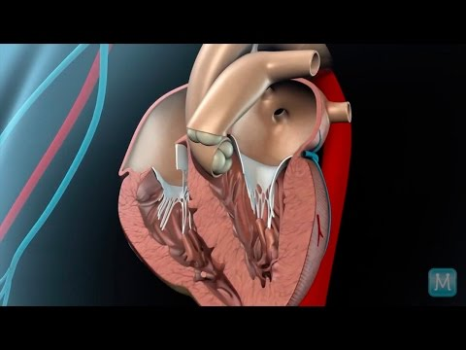
The heart
Pulmonary artery

Slide 9
Questions waiting to be answered;
How can you recognize what is left / right (not literally) when you see a picture of your heart?
Why do we use red / blue in pictures about the circulatory system?
There is a difference in thickness of the (ventricles) walls. What is the difference and why?
Pulmonary arteries; why 2?
How does the heart get its blood?
Why does the heart need blood?
Why are there different names for the valves on the right / left sides?
What is the function of the valves?
Sometimes the bicuspid valves has a problem. Explain what is wrong and what the cause is.

Slide 10
Homework
Questions 1-13 of chapter 3
Read 3.2

Slide 11
Let's talk about circulation
Coronary circulation;
what is the function?
which veins / arteries are involved?
Pulmonary circulation;
what is the function?
which veins / arteries are involved?
Systemic circulation;
what is the function?
which veins / arteries are involved?

Slide 12
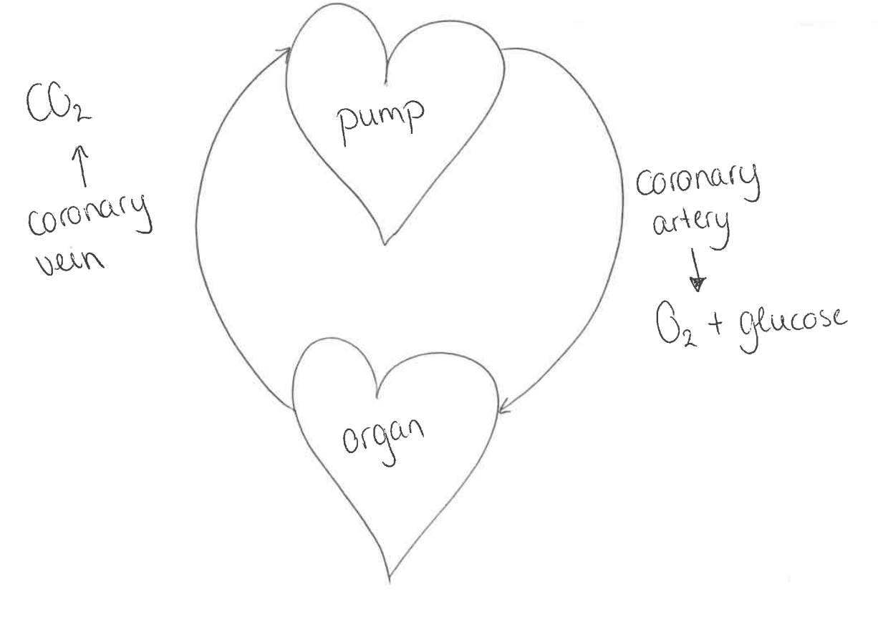
The coronary circulation

Slide 13
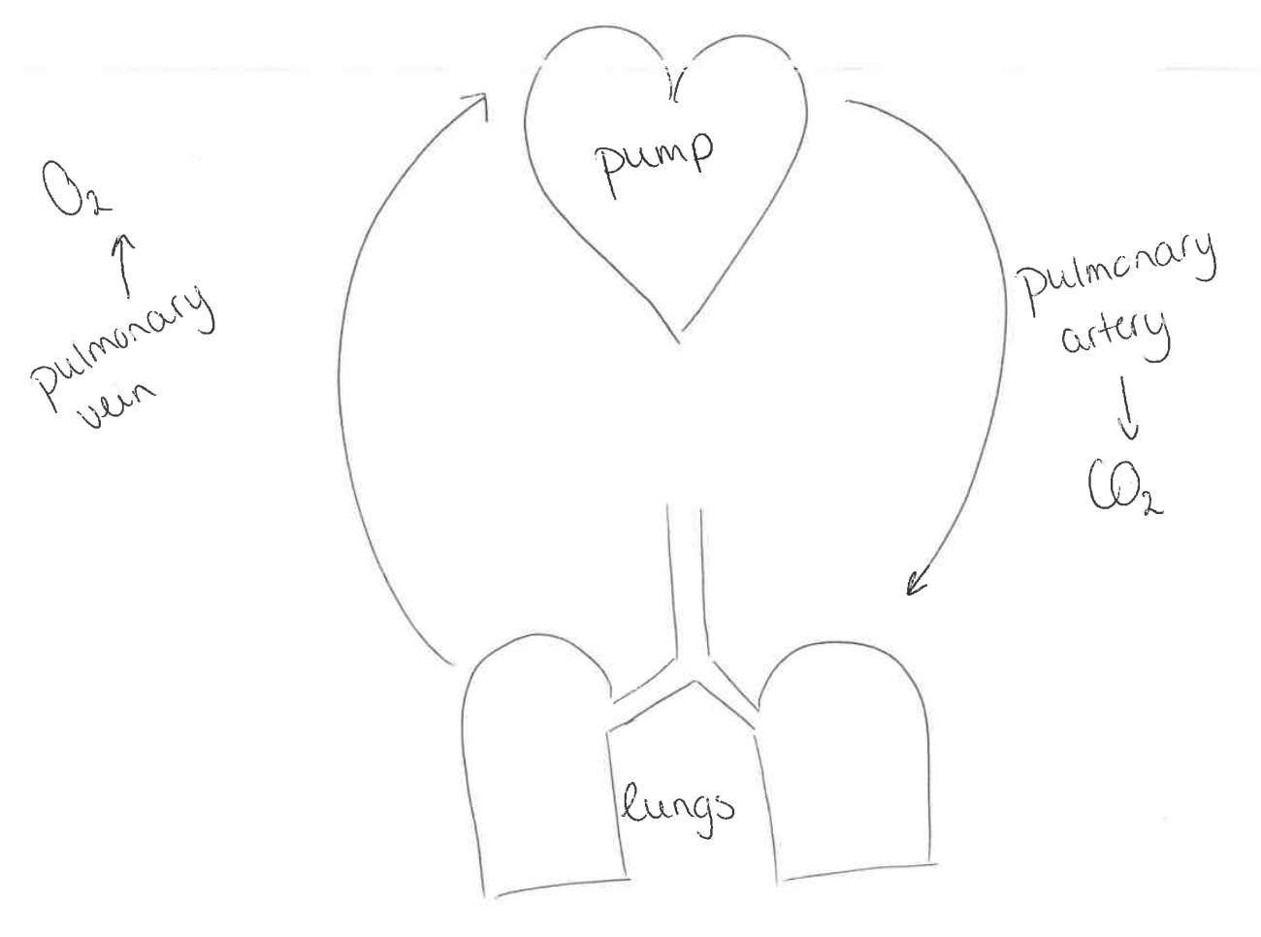
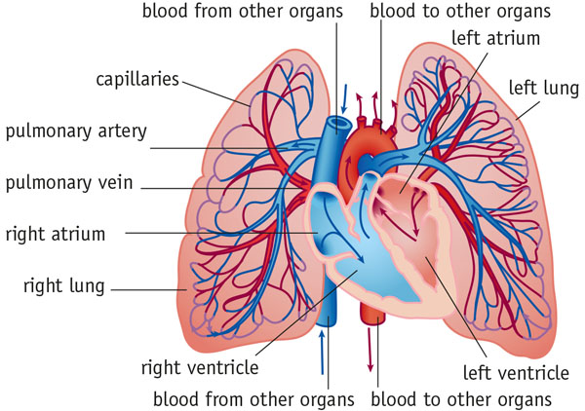
The pulmonary circulation
CO₂ is released in the lungs and O₂ is taken into the blood (= gass exchange)

Slide 14
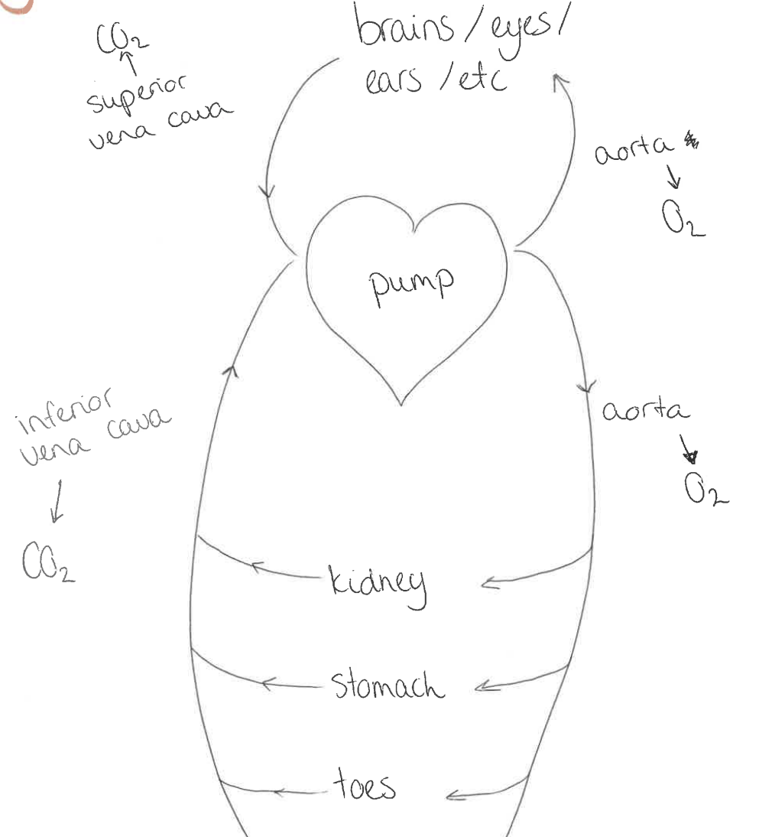
Systematic circulation
Oxygen is used by the cells (=respiration) and therefore blood becomes deoxygenated.

Slide 15
Homework
Questions of 3.2
Glossary 3.2

Slide 16
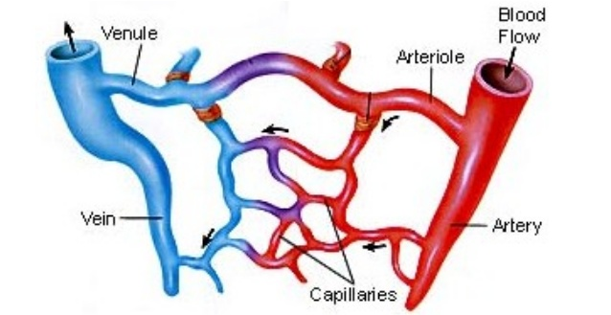
Blood flows through….
Are all arteries / arterioles “red” and venules / veins “blue”? Explain
Write down the steps in your bloodflow for the 3 circulations

Slide 17
Coronary circulation;
heart - coronary artery - coronary arteriole - coronary capillary - coronary venule - coronary vein - heart
Pulmonary circulation;
heart - pulmonary artery - pulmonary arteriole - pulmonary capillary - pulmonary venule - pulmonary vein - heart
Systemic circulation;
heart - aorta - arteriole - capillary - venule - vena cava - heart

Slide 18
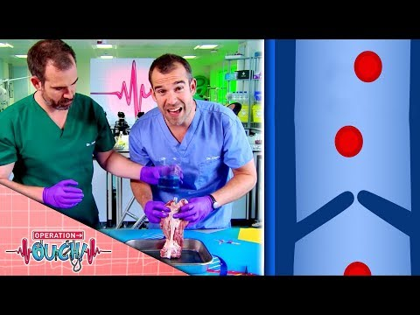

Slide 19
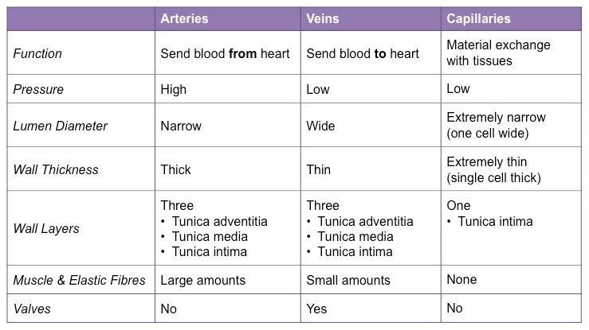
Arteries vs capillaries vs veins

Slide 20
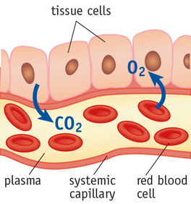

Slide 21
Homework
Read 3.4

Slide 22
Question-time!
Questions waiting to be answered;
What is blood pressure?
What is the difference between systolic and diastolic pressure?
What does the medical term “hypertension” mean?
What can be a consequence (or more than one) of hypertension?
What are some causes of hypertension?
Try to write down the answers with your group. After a few minutes we will watch a video (if needed, twice) to find the right answers!

Slide 23
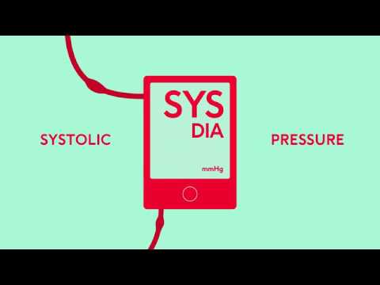

Slide 24
How about your blood pressure and pulse?
What does a doctor hear when checking you heart?
How about your blood pressure?
FIND OUT!
Homework
Questions of 3.4
Glossary 3.4
Read 3.5

Slide 25
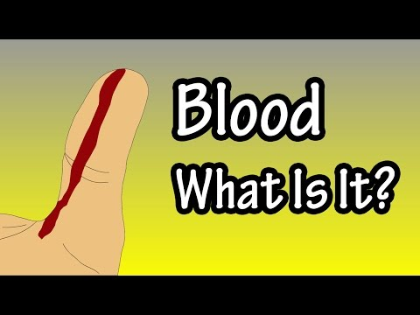
Lets get bloody

Slide 26
Red vs White
No nuclei | Nuclei
Haemoglobin; transport oxygen | To fight against invasive materials
Disc-shaped, stay within bloodvessel | No fixed shape, can leave bloodvessel
Live about 120 days | Die when done fighting
Produced, daily, in bone marrow | Produced in bone marrow, increasing when needed
Broken down in spleen. liver of bone marrow. Haemoglobin is recycled | Broken down in lymph nod, spleen, liver

Slide 27
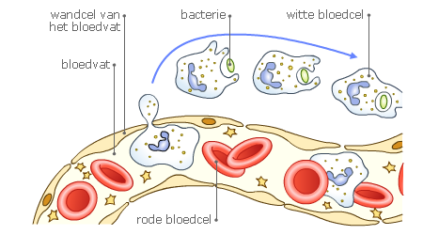
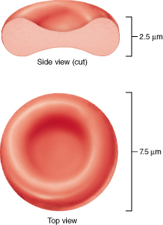
bacteria
white blood cell
capillarie
blood plasma
red blood cell
Phagocytes (a type of white blood cell) “eat” a bacteria, we call this phagocytosis
bacterial cell with antigens
Lymphocyte producing antibodies
The antibodies cover the antigens, the bacteria will be killed
Lymphocytes (a type of white blood cell) create antibodies, specific to antigens on a bacterial cell wall.

Slide 28
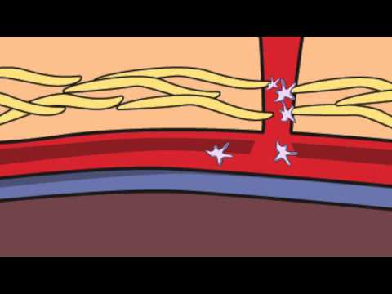
Clothing

Slide 29
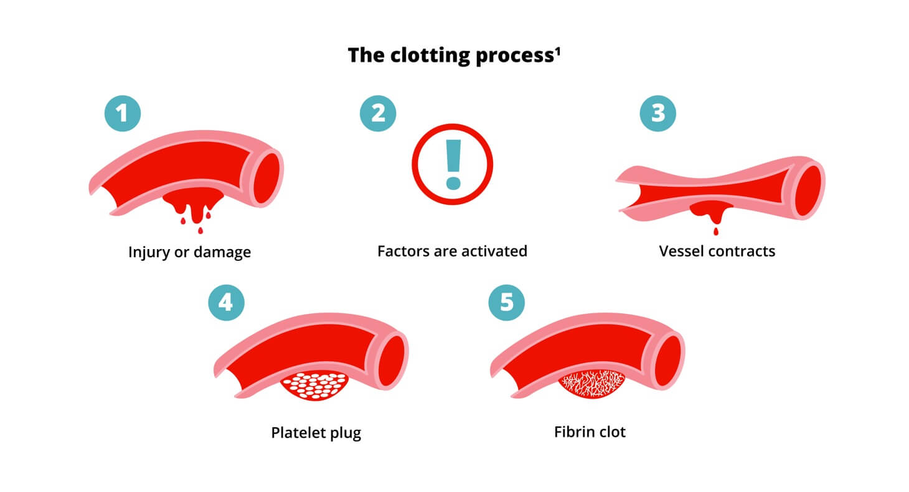
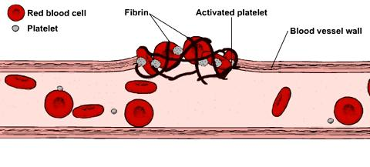

Slide 30
Homework
Questions of 3.5 and 3.6
Glossary 3.5 and 3.6

Slide 31
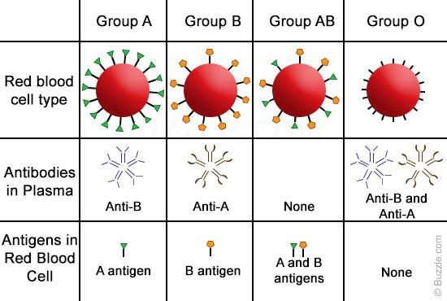
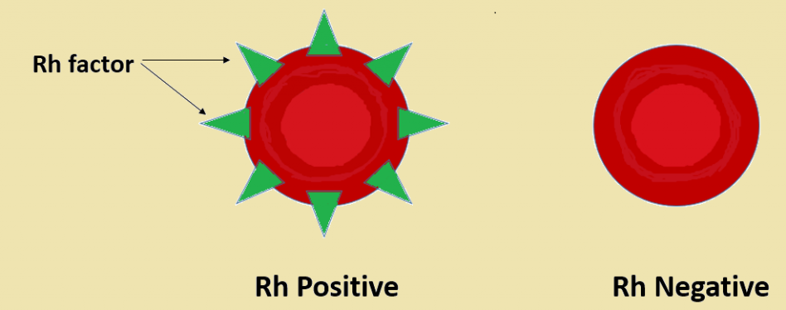
Blood types
Antigens on the membrane
Produced by white blood cells, when in contact with antigens
No antibodies will be produced
Antibodies, against Rhesus will be produced

Slide 32
Note; donor blood consist only of red blood cells
What will happen when;
A will receive B
O will receive A

Slide 33
A receiving B
A
B
+
→
A
B
+
This blood will cloth!!!
O receiving A
O
A
+
→
O
A
+
This blood will cloth!!!

Slide 34
Homework
Questions of 3.7
Glossary 3.7

Slide 35
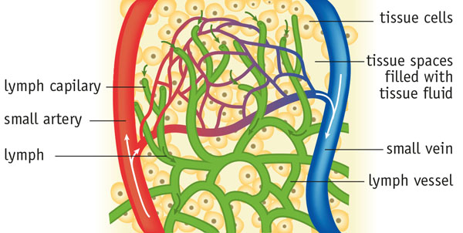
Lymphatic system
Step by step;
fluid (including nutrients, oxygen) leave the blood vessel and enters the tissue (=tissue fluid)
nutrients and oxygen is absorbed by the cells
waste products leave the cells and enter the tissue fluid
tissue fluid goes to
a blood vessel
lymph vessel

Slide 36
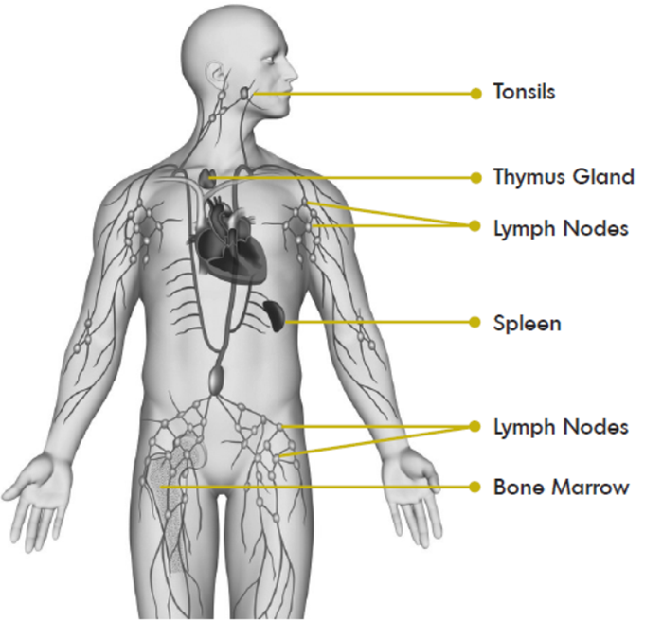
all the lymph vessels pass nodes to filter your blood from invaders
near your enter the main lymph vessel is connected to a bloddvessel. your lymph fluid is “dumped” in your blood

Slide 37
Homework
Questions of 3.8
Glossary 3.8

Slide 38
Wordweb
Go to www.menti.com and use the given code.
Fill in as many words related to this chapter.
The teacher will talk with the class about the words.

Slide 39
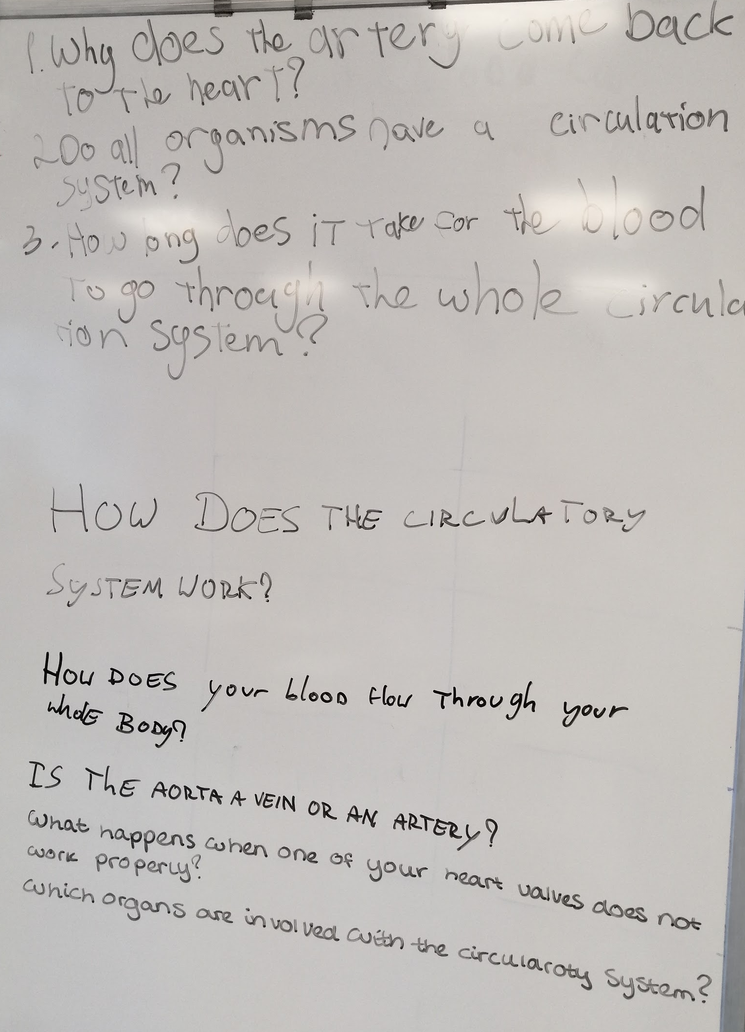
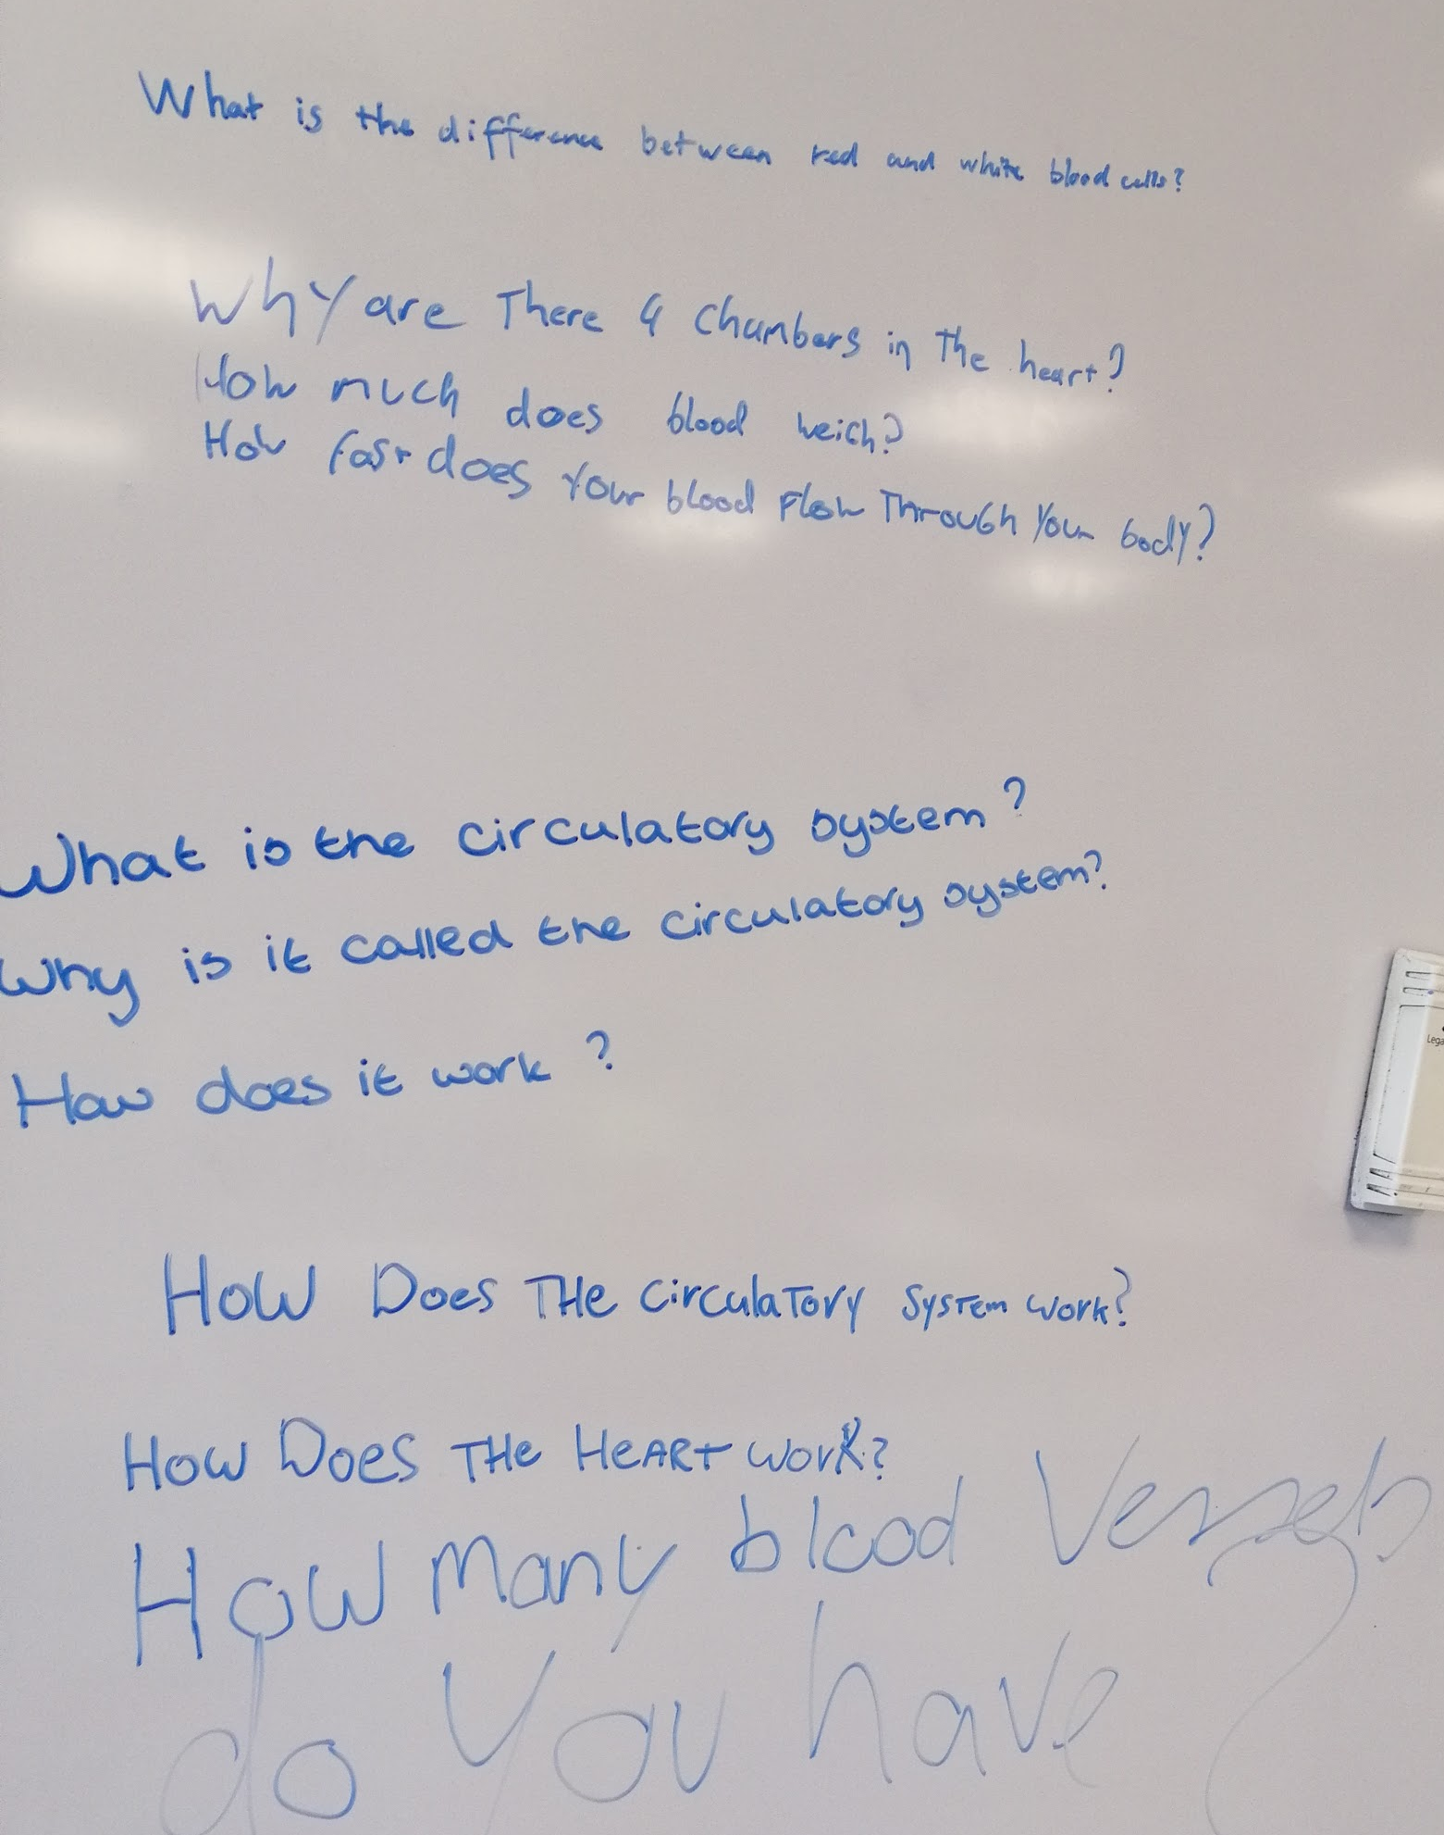
Hebben we geleerd wat we wilden?

